Slide 1
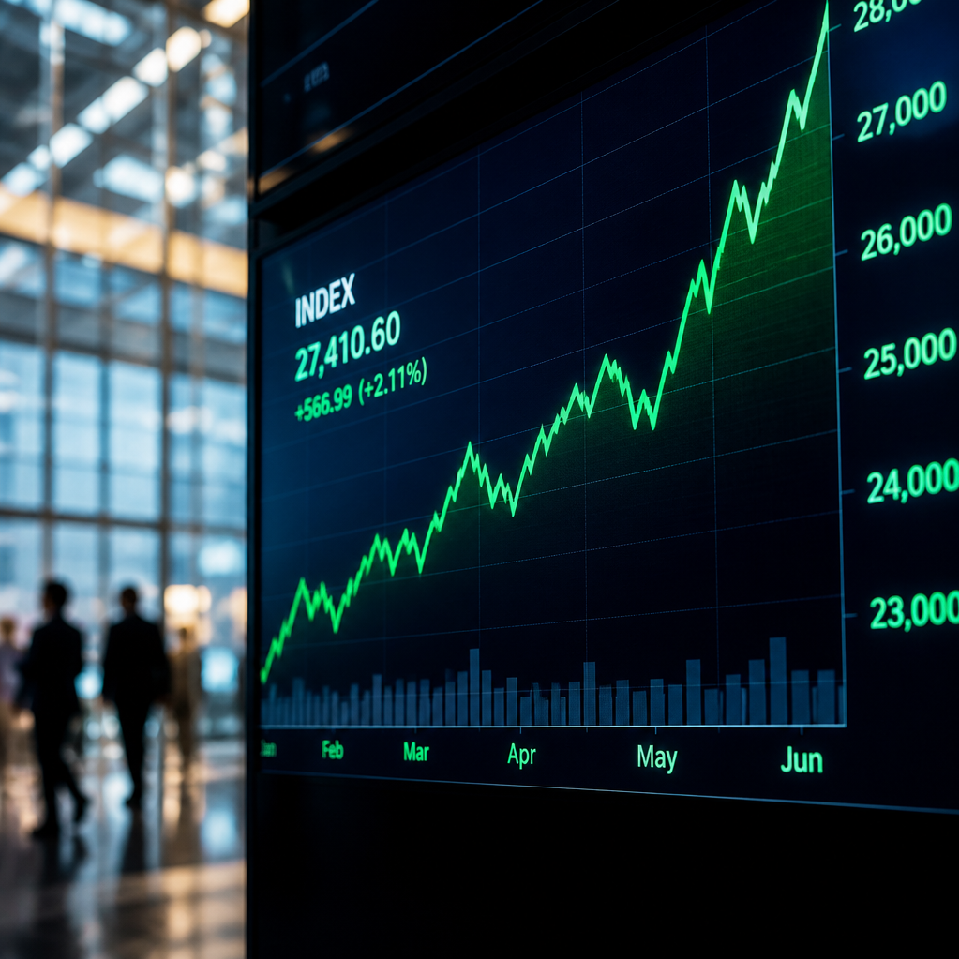
The 2026 US IPO Surge: An Overview
Analyzing the factors driving market activity and investor sentiment
Unprecedented Issuance
  2026 has witnessed a record-high surge in US Initial Public Offering (IPO)
  activity.
Core Investor Concerns
  Market participants are evaluating potential bubble risks and the overall
  capacity for the market to absorb new supply.
Expert Perspectives
  Key insights provided by analysts including Ben Snider (Goldman Sachs),
  Jay Ritter (IPO Initiative), and Owen Lamont (Acadian Asset Management).

Slide 2



Is This an 'IPO Wave'?
Assessing current market activity against historical benchmarks
Market Consensus
Normalization Context
Historical Comparison
Current market activity is not meeting the
established thresholds for volume or
frequency required to classify this as a
true 'IPO wave'.
The current landscape is a period of
normalization, driven largely by a small
number of landmark deals in the AI
infrastructure sector.
Issuance levels remain significantly below
the speculative peaks seen during
historical benchmarks like 1999 and 2021.

Slide 3

Assessing the 'Red Flag' Risks
Current market indicators and IPO activity analysis
Absence of Late-Cycle Warning
Signs
Balanced IPO Market
Reframing Issuance Volume
Valuations remain modestly above long-
term averages, but stay well below
historical boom cycle peaks.
High IPO volume is a weak predictor of
downturns and often signals broader
economic confidence.
Indicators like stretched valuations and
speculative euphoria have not hit critical
thresholds.

Slide 4

Market Digestion: Can the Market Absorb the Supply?
Analyzing the resilience and balance of US equity market supply dynamics
Robust Market Liquidity
Offsetting Corporate
Activity
Self-Limiting Dynamics
The depth of the US equity market
enables it to absorb new issuance
efficiently without causing systemic
disruption.
The IPO market is inherently reactive,
naturally slowing issuance volume
when investor demand wanes to
ensure market equilibrium.
Sustained buyback programs and
consistent dividend payouts serve as
a vital counterbalance to new equity
supply.

Slide 5

The Role of AI and Debt Issuance
Analyzing the impact of AI infrastructure investment on capital markets
AI-Driven Capex as Catalyst
Debt Issuance Risks
Credit Market Constraints
Massive investment in AI infrastructure
is fueling a surge in both equity and
debt issuance across various sectors.
Simultaneous large-scale debt and
equity issuance may signal capital
sustainability concerns to investors.
Future financing is hindered by issuer
concentration and reaching the ceiling
of investor appetite for AI-specific debt.

Slide 6


Global Perspectives: Europe and Hong Kong
Comparative Analysis of Regional IPO Landscapes
Europe
Hong Kong
Faces a more constrained IPO outlook due to a persistent lack
of structural domestic equity inflows.
Staged a powerful resurgence in 2025-2026, driven by
strategic policy pivots and expansion into 'Hard Tech' listings.
Global issuance is increasingly being driven by opportunity rather than financial stress.

Slide 7



Investor Takeaways and Future Outlook
Key strategies for navigating IPO investments
Exercise Patience
Diversified Strategy
Monitor Critical Indicators
Historically, IPOs tend to demonstrate
stronger performance after an initial
'ripening' period.
Building a portfolio of multiple IPOs is
typically more effective than attempting to
select individual winners.
Watch first-day returns as a sentiment
gauge, keep an eye on the AI sector
outlook, and track expiring lockup supply.

