Slide 1


Executive Summary: October 2019 Snapshot
Key Financial Performance Indicators
Revenue
Total Cost of Sales
Gross Profit
97408
54407
43000
Total Expenses
Net Income
Growth Trend (vs 12-Month Avg)
26531
23442
94%
Growth Trend: -6.39% compared to rolling 12-month average.

Slide 2
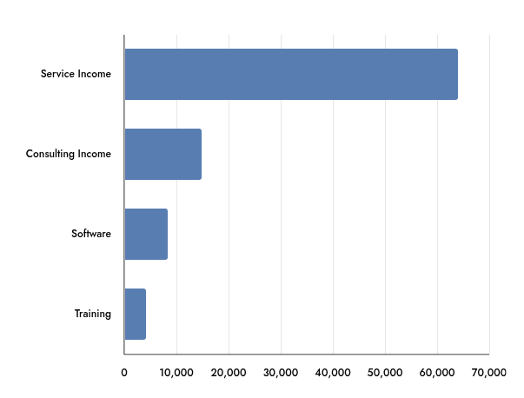
Revenue Breakdown
Year-to-Date Financial Performance
Total YTD Revenue
Monthly Revenue Contribution
$391,207

Slide 3
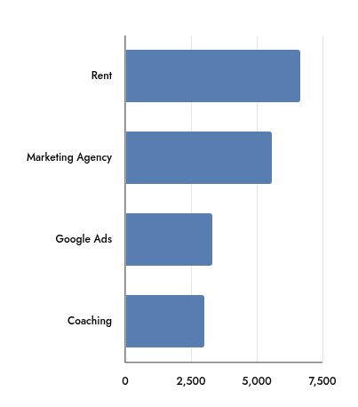
Expense Analysis
YTD Financial Overview
Total Cost of Sales
Total Operating Expenses
Top Monthly Expenses
$229,256
$118,959

Slide 4
Breakeven Analysis
Financial Position Overview
Current Revenue
Breakeven Point
$97,408
$60,099
Total Costs
Margin of Safety
$80,938
$37,308
The business demonstrates a strong financial position, with current revenue
exceeding the breakeven point and maintaining a healthy margin of safety.

Slide 5
Cash Flow Overview
Financial Performance Summary
Operating Cash Flow
Net Cash Flow
-$6,423
-$6,968
Free Cash Flow
-$7,007
Closing Cash Balance: $137,923 (Month-End)

Slide 6
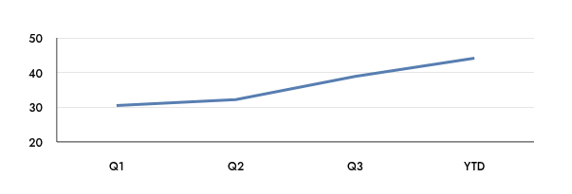


Profitability and Growth Trajectory
Financial Performance Summary
Net Profit (YTD)
Margin Trend Improvement
$70,495
Gross Profit Margin
Strategic Focus
44%
Transitioning toward disciplined growth, maintaining positive
EBIT trends, and prioritizing operational efficiency and
margin sustainability.

Slide 7

Financial Health: Balance Sheet
Summary of current assets, liabilities, and liquidity
Total Assets
Total Liabilities
Total Equity
191406
100162
91243
Quick Ratio
Primary Asset Driver
98%
Cash & Equivalents: $137,923

Slide 8



Key Performance Indicators (KPIs)
Financial Efficiency and Working Capital Performance
Gross Profit Margin
Profitability Ratio
Return on Equity (ROE)
44%
24%
407.08%
AR Days
AP Days
18
33
days
days

