Slide 1

Introduction to Unitree Go1
Advanced Quadruped Robotics Overview
High-Motion
Performance
  Advanced quadruped design
  built for high agility and
  speed.
12 Degrees of Freedom
  Equipped with high-
  performance servo motors for
  precision movement.
Force Control
Technology
  State-of-the-art systems to
  manage complex terrain
  interaction.
Super-Sensing System
  Features autonomous
  accompanying and obstacle
  detection capabilities.
Compact & Portable
  Lightweight 12kg frame
  designed for versatile
  deployment.

Slide 2



Getting Started: Setup
A step-by-step guide to preparing your device for operation
Unpacking
Battery
Installation
Body Placement
Controller
Pairing
Place the unit on flat
ground and carefully
remove all velcro
straps.
Ensure the device is
positioned
horizontally on
stable, level ground.
Insert the battery
into the compartment
correctly; do not
force it into place.
Connect the joystick
via Bluetooth or
wireless and sync with
the mobile app for
video feed.

Slide 3
Operating Modes
Platform configuration and safety guidelines
Static Standing State
Sports Mode
Accompanying Status
Maintains minimal power
consumption while ensuring
platform stability.
Optimized for high-performance
locomotion, including walking
and fast running cycles.
Utilizes the tag controller for
dynamic, autonomous following
capabilities.
Safety Note: Always operate in open, flat environments; remain clear of crowds and potential obstacles.

Slide 4


Control Modules
Overview of system control interfaces
Joystick
Label Controller
APP/Web Interface
Provides 3-axis posture and
position control with an
ergonomic design for intuitive
operation.
Enables automatic following
functionality and supports
seamless switching between slow
and fast follow modes.
Central hub for advanced
configuration, firmware
management, and real-time camera
feed monitoring.

Slide 5
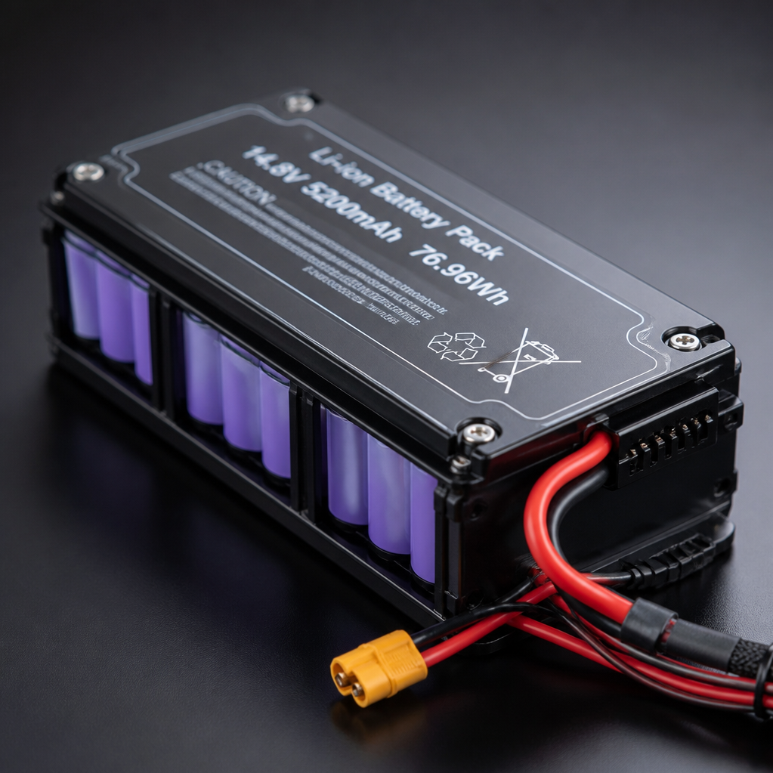
Battery Safety & Maintenance
Guidelines for safe operation and longevity of your Unitree battery
Charging
  Use only the official Unitree charger to ensure full
  compatibility and safety.
Storage
  Remove the battery when not in use; maintain an optimal storage
  temperature of 22-28°C.
Protection
  Benefit from built-in safeguards against overload, over-
  discharge, and thermal issues.
Warning
  Never charge immediately after use; allow the hardware to cool
  to room temperature first.

Slide 6


Safety & Disclaimer
Operational guidelines and warranty information
Not a toy
Environment
Warranty
Emergency
Use strictly according
to the provided user
manual.
Avoid exposure to
water, ice, sand, or
high electromagnetic
interference.
Void if the product is
modified, disassembled,
or used in
severe/prohibited
environments.
Familiarize yourself
with emergency braking
and shutdown
procedures.

