Slide 1
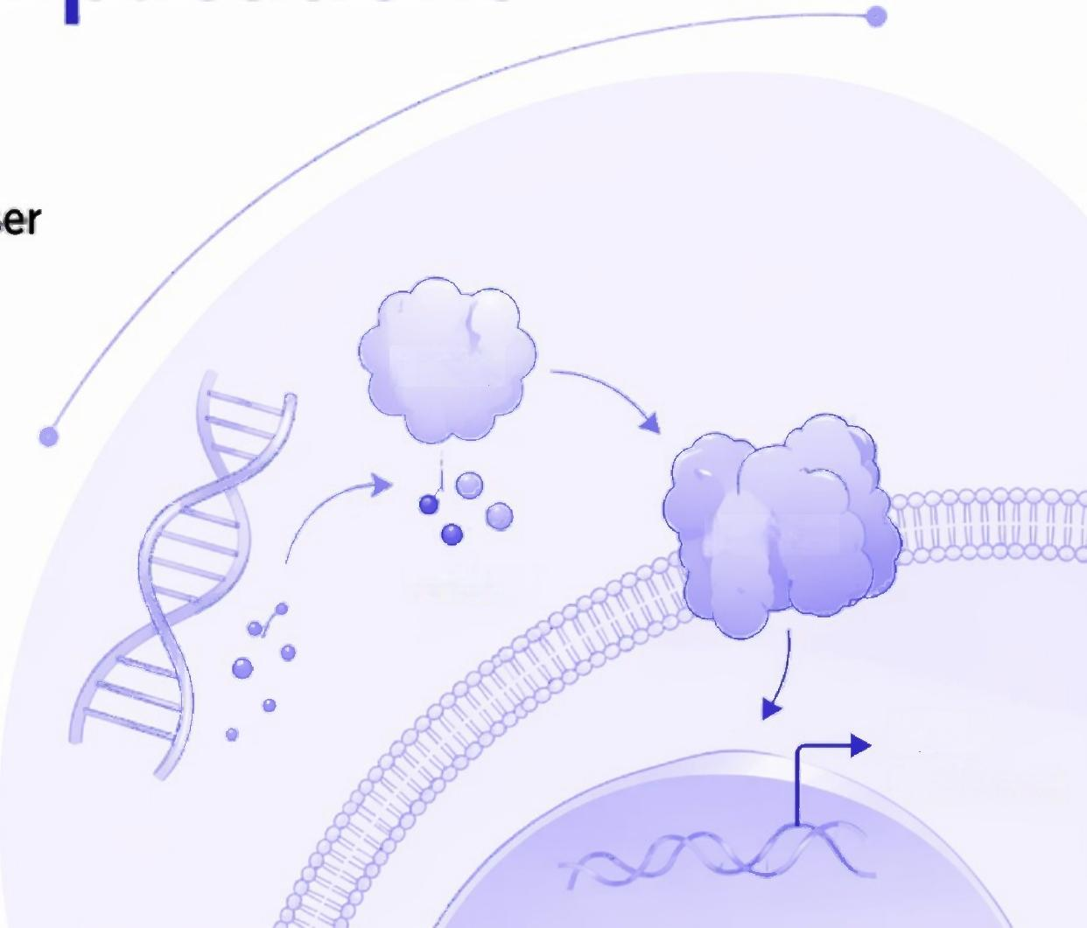

The cGAS-STING pathway:
Mechanism and medical implications
8 Alexander Hooftman,Alexander Keller,and Andrea Ablasser
1 Global Health Institute,Swiss Federal Institute of Technology Lausanne(EPFL),Lausanne,Switzerland
2 Institute for Cancer Research(ISREC),Swiss Federal Institute of Technology Lausanne(EPFL),
Lausanne,Switzerland
cGAS
STING
cGAMP
Type l
interferons
Notes:
Good morning. My name is [Your Name], and today I will be presenting a review of the paper 'The cGAS-STING pathway: Mechanism and medical implications' by Hooftman, Keller, and Ablasser. This work provides a comprehensive overview of a central mechanism in innate immunity, detailing its molecular functions, physiological roles, and its growing relevance in both health and a wide range of diseases.

Slide 2



Presentati on Outline
01
03
05
Introduction:
The fundamental challenge of cytosolic DNA sensing.
Activation & Regulation:
A deep dive into cGAS activation and
its stringent control.
Broader Implications:
Non-cell-autonomous signaling and
the pathway's dual role in disease.
02
04
06
Core Mechanism:
The canonical cGAS-STING signaling cascade.
Effector Functions:
The diverse transcriptional and
non-transcriptional outcomes of STING signaling.
Conclusion:
Key takeaways and future research directions.
Notes:
Here is the roadmap for our discussion. We will begin by introducing the core problem that the cGAS-STING pathway solves: how cells distinguish pathogenic or harmful DNA from the host's own genomic material. We will then walk through the canonical signaling cascade, followed by a more detailed look at the molecular mechanisms of cGAS activation and the critical safeguards that prevent autoreactivity. Next, we'll explore the diverse effector functions driven by STING, and discuss the broader implications, including intercellular communication and the pathway's dichotomous role in health and disease. Finally, we will conclude with a summary and a look at future directions for the field.

Slide 3
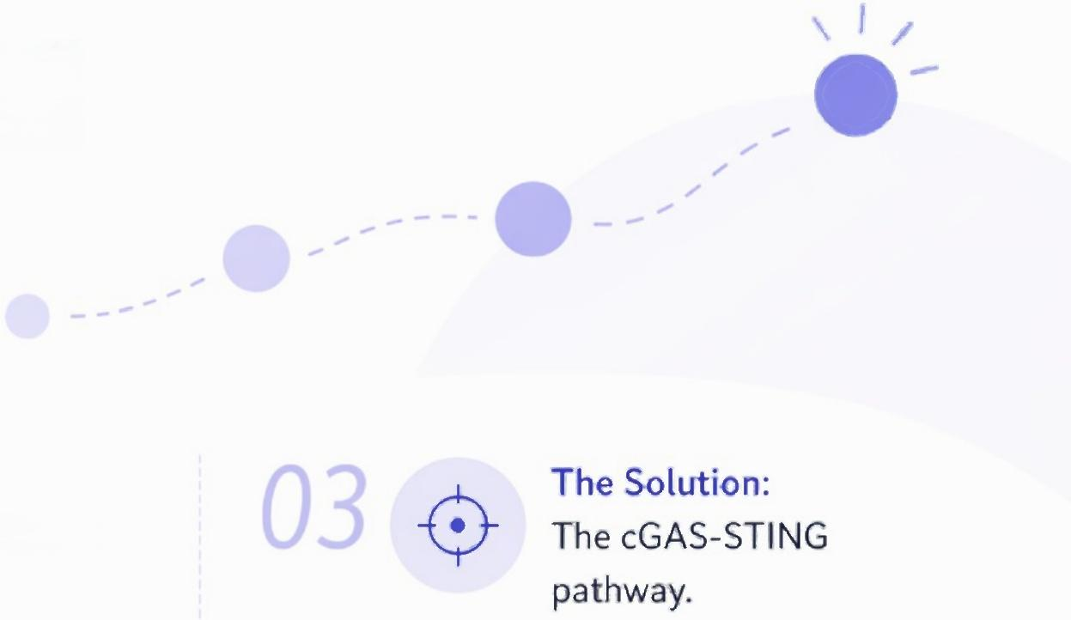


Introduction:The Challenge of Cytosolic DNA Sensing
The Problem:
Distinguishing self vs. non-self DNA.
02
The Context:
DNA should not be in the cytosol.
01
● Double-stranded DNA(dsDNA)is a
universal molecular signal for viral infection, but it's structurally indistinguishable from the host's own DNA.
● This poses a fundamental challenge to the innate immune system's principle of
pattern recognition.
· In healthy cells,host dsDNA is strictly compartmentalized within the nucleus and mitochondria.
● The presence of dsDNA in the cytosol is a key danger signal,indicating either
pathogen invasion or endogenous stress (e.g.,genome instability, mitochondrial damage).
● This pathway acts as a primary sensor
for cytosolic dsDNA,initiating potent immune responses,including the
production of type linterferons(IFNs).
The cGAS-STING pathway is central to linking the detection of cytosolic DNA to a robust antiviral state,
bridging innate immune sensing with adaptive immunity.
Notes:
The central question this field addresses is a fundamental one for innate immunity: How does a cell detect the DNA of an invading pathogen without triggering an autoimmune attack against its own DNA? The molecular structure of dsDNA is the same, whether it comes from a virus or the host. The key insight is that location matters. Host DNA is carefully sequestered in the nucleus and mitochondria. Therefore, the appearance of dsDNA in the cytosol is a powerful indicator of danger—be it a viral infection or a sign of significant cellular damage. The cGAS-STING pathway has emerged as the central cellular machinery that recognizes this misplaced DNA and translates it into a powerful defensive response.

Slide 4

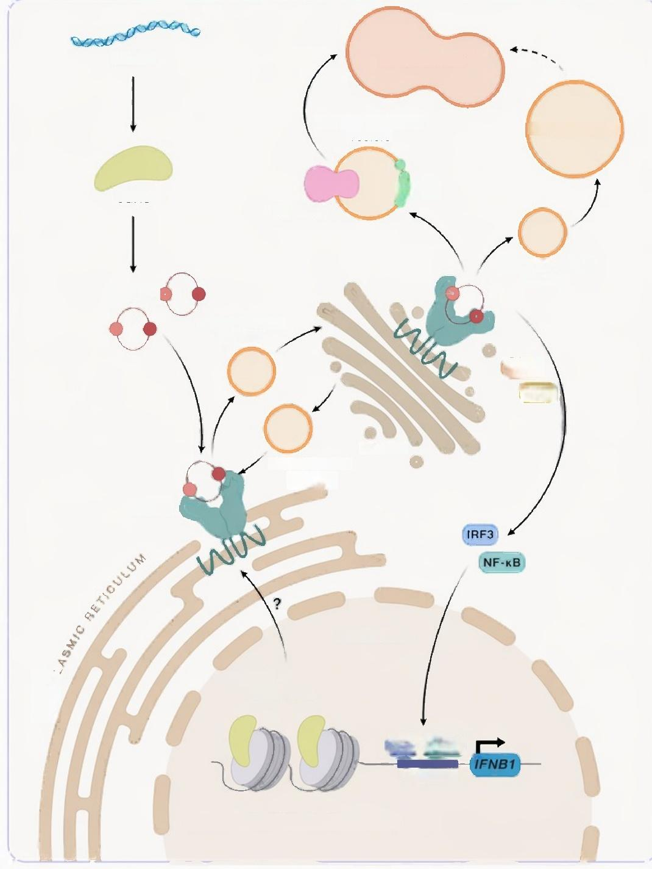


Mechanism: The Core
cGAS-STING Signaling Cascade
dsDNA
Single-membrane
vesicle
cGAS
V-ATPase
Clathrin-coated vesicle
cGAMP
COP Il coated
vesicle
TBK1
IKKe
GOLGI
COP-I coated
vesicle
STING
NUCLEUS
Mobilized upon
activation
IRF3 NF-k B
Promoter
Nuclear cGAS
("silenced on the nucloosome")
LYSoSOME
ENDOSOME
③
OLC3
Sensor(cGAS): Cyclic GMP-AMP synthase(cGAS)is the cytosolic DNA sensor.
● Upon binding dsDNA,cGAS is enzymatically activated.
Second Messenger(cGAMP): Activated cGAS synthesizes the cyclic dinucleotide 2'3'-cyclic GMP-AMP(cGAMP)
from ATP and GTP.
Adaptor( STING): cGAMP diffuses through the cytosol and binds to the STING protein,which is anchored in the
Endoplasmic Reticulum(ER).
Signal Transduction:
● cGAMP binding triggers a conformational change in STING, leading to its oligomerization and trafficking from the ER to the Golgi.
● TBK1 then phosphorylates the transcription factor IRF3,
leading to its nuclear translocation.
● This cascade results in the transcription of type IIFNs and other pro-inflammatory cytokines,initiating a broad antiviral
state.
● At the Golgi,STING serves as a scaffold to recruit and activate the kinase TBK1.
ENDOP
Figure 1:The cGAS-STING pathway.This diagram illustrates the complete signaling cascade from cytosolic DNA detection by cGAS to the transcriptional activation of
immune response genes.
Notes:
Let's walk through the core pathway, as illustrated in this figure. It begins in the cytosol when cGAS encounters and binds to dsDNA. This binding event is the critical trigger that activates its enzymatic function. Once active, cGAS synthesizes a unique second messenger molecule, 2'3'-cGAMP. As a small, diffusible molecule, cGAMP can rapidly move through the cytosol to find its target: the adaptor protein STING, which resides on the ER membrane. Ligand binding initiates a dramatic series of events for STING—it changes shape, forms a polymer-like structure, and translocates to the Golgi apparatus. The Golgi then becomes a signaling hub where STING recruits the kinase TBK1. TBK1 phosphorylates the transcription factor IRF3, which then moves to the nucleus to drive the expression of type I interferons and other crucial immune genes. This entire process exemplifies a beautiful signal amplification system, translating a local DNA sensing event into a robust, cell-wide antiviral response.

Slide 5

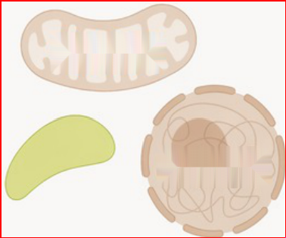
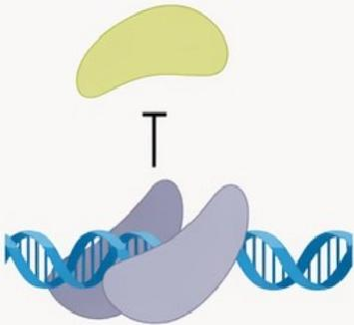




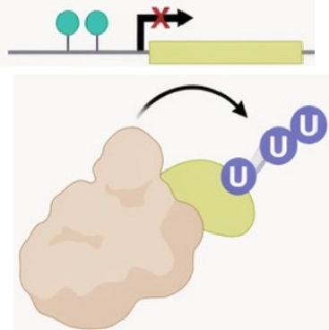
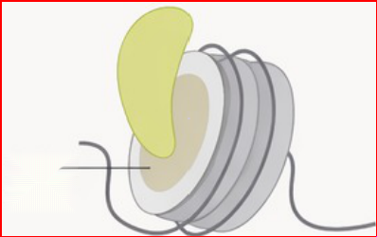

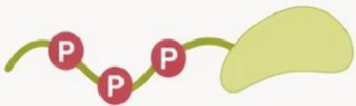


Mechanism:Allosteric Activation and Regulation of cGAS
DNA-Dependent Activation:A finely tuned allosteric mechanism.
Structure: cGAS consists of a catalytic C-terminal domain and a disordered,positively charged N-terminal domain.
Activation Step:Binding of dsDNA induces cGAS dimerization,
forming a 2:2 cGAS-dsDNA complex.This stabilizes the active enzyme conformation and opens the catalytic pocket.
Amplification: On long dsDNA,cGAS dimers form cooperative, ladder-like oligomers,enhancing activity.The N-terminal domain further promotes liquid-liquid phase separation,concentrating components and amplifying the signal.
Nuclear Regulation:Preventing activation by self genomic DNA.
Key Insight:A large pool of cGAS resides in the nucleus,where it must be kept inactive.
Primary Mechanism:Nuclear cGAS is tightly sequestered on chromatin through a high-affinity protein-protein interaction with the acidic patch of histone H2A-H2B dimers on the nucleosome.This binding sterically occludes the DNA binding site,preventing cGAS dimerization and
enzymatic activation.
Additional Safeguards:Chromatin architectural proteins like BAF and histone H1 further restrict cGAS access to naked DNA.
Nucleolytic activity | B Spatial separation | _{C} Competition
 | 四四W① ULL
D Post-translational modification | E Protein abundance | _{F} Nucleosome binding
 |  | Acidic- patch
Figure 2: Principles of cGAS regulation.This figure highlights the multiple
layers of control that limit inappropriate cGAS activation,with a key focus on the sequestration of nuclear cGAS by nucleosomes(F).
Notes:
Now for a deeper dive into the molecular mechanics. The activation of cGAS is not a simple on/off switch; it's a sophisticated allosteric process. When cGAS binds dsDNA, it undergoes dimerization. This critical step forces a conformational rearrangement within the catalytic core, opening the active site for cGAMP synthesis. The system is also designed for signal amplification: longer DNA molecules allow for the formation of ladder-like cGAS oligomers, and the disordered N-terminus can drive phase separation, creating localized 'reaction crucibles' that boost cGAMP production. But this potent activity creates a major problem in the nucleus, which is filled with DNA. As shown in panel F of this figure, the cell's primary solution is elegant: nuclear cGAS is physically tethered to the nucleosome itself. The cGAS protein binds directly to the histone H2A-H2B acidic patch, a protein-protein interaction that sterically blocks the enzyme from accessing DNA, thus enforcing its inactivity. This sequestration is a critical mechanism for maintaining self-tolerance.

Slide 6
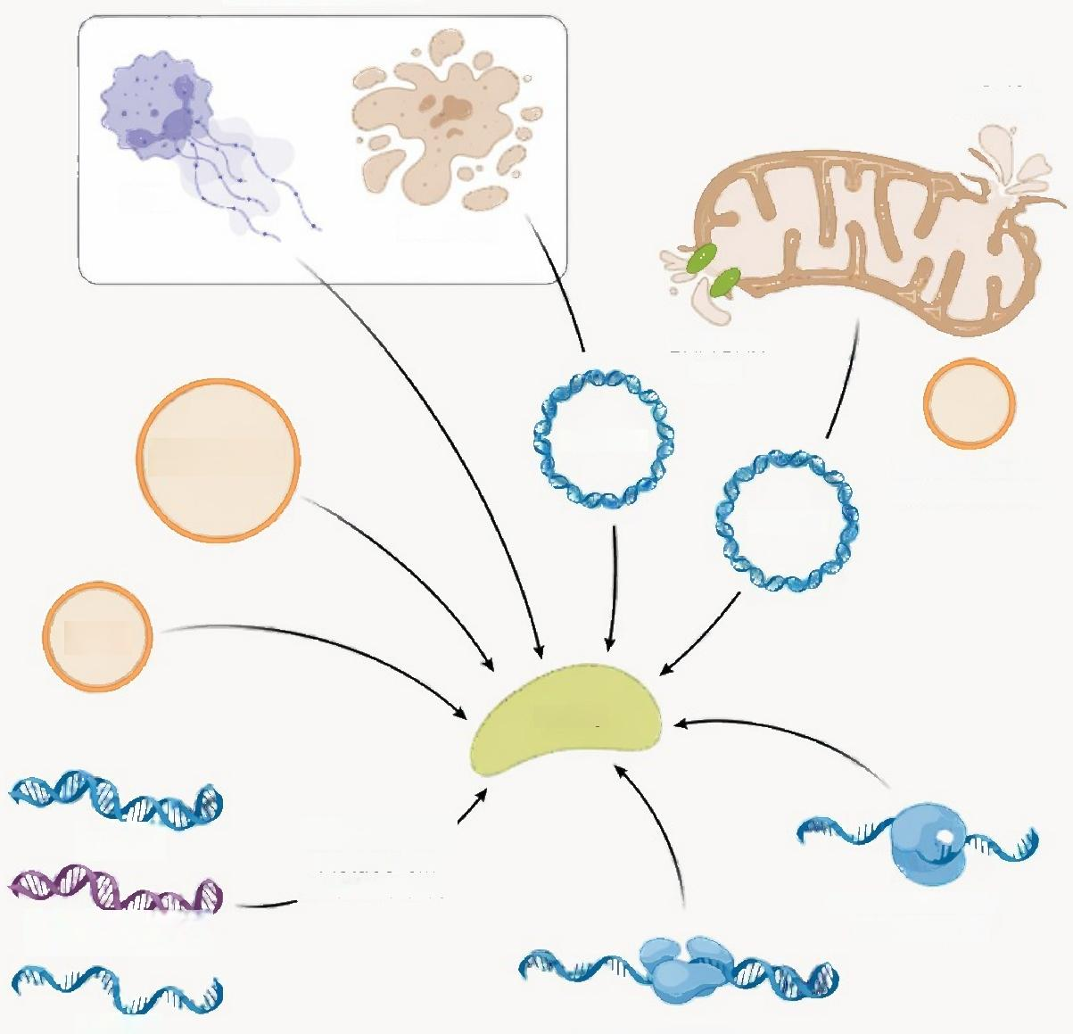


Results:Diverse Endogenous
DNA Sources Can Activate cGAS
Extracellular DNA
VDAC
channel
NETs
Dead cell
BAX/BAK
pore
eccDNA
Micronuclei
derived vesicle
mtDNA
CCFs
cGAS
Aberrant DNA
metabolism
^{intermediates} _{Centromeric} _{DNA}
amplification
ssDNA Retrotransposon
Context :Pathogen infection is not the only trigger.
Endogenous DNA generated during cellular stress is
a major driver of cGAS-STING signaling.
Key Endogenous Ligands:
Mitochondrial DNA(mtDNA):Released into the cytosol during mitochondrial stress,damage,or permeabilization(e.g.,via
BAX/BAK pores).mtDNA is a particularly potent cGAS activator.
Micronuclei:Arise from genome instability and chromosome
mis-segregation.These structures have unstable nuclear
envelopes that can rupture,exposing chromatin to cytosolic cGAS.
DNA Repair Byproducts: Accumulation of DNA-RNA hybrids, R-loops,and other intermediates from genotoxic stress can be immunostimulatory.
Extrachromosomal Circular DNAs(eccDNAs):Originate from genomic fragments and can be released from dying cells,acting as non-cell-autonomous signals.
Endogenous Retroelements:Derepression of elements like LINE-1 can lead to the generation of cytosolic cDNA intermediates that
are sensed by cGAS.
Mitochondria-
dsDNA
DNA-RNA hybrid
Figure 3:Endogenous DNA sources activating cGAS.This schematic shows the multiple pathways through which self-DNA can become a ligand for cGAS.
Notes:
Now that we understand how cGAS is activated, the next question is what activates it. While viral DNA is the canonical trigger, a host of endogenous DNA species released during cellular stress are now understood to be major drivers of the pathway. As this figure illustrates, the sources are remarkably diverse. Mitochondrial DNA, released from stressed or damaged mitochondria, is a primary culprit. Genome instability, a hallmark of cancer and aging, can lead to the formation of micronuclei, which are essentially small, fragile packets of chromosomal DNA that can rupture and spill their contents into the cytosol. Furthermore, byproducts of defective DNA replication and repair, such as DNA-RNA hybrids, can also serve as ligands. Finally, the reactivation of dormant retroelements in our genome can produce reverse-transcribed cDNA that is readily detected by cGAS. This diversity of endogenous ligands is key to understanding why the cGAS-STING pathway is implicated in so many non-infectious, sterile inflammatory conditions.

Slide 7


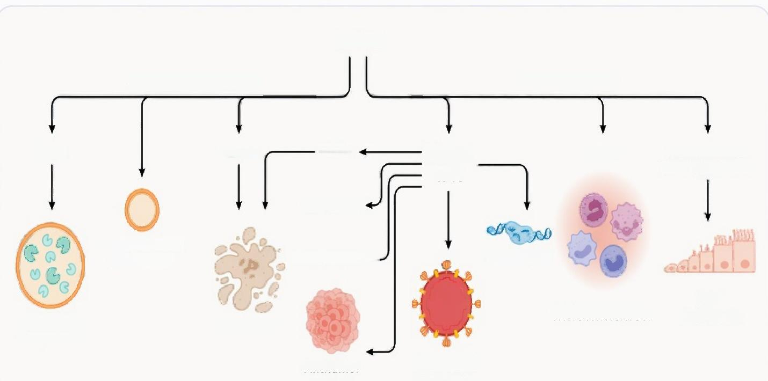




Results: STING Engagement Drives Diverse Effector Functions
Key Concept:STING activation is not a one-dimensional pathway.It triggers a stratified response with both transcriptional and
non-transcriptional outcomes.
● Transcriptional Responses:
Canonical (Type l IFN): Driven by IRF3 phosphorylation
at the Golgi. The primary antiviral response.
NF-kB Signaling: Activated downstream of the Golgi,
leading to pro-inflammatory cytokine production.
Non-Canonical NF-kB/ER Stress: Occurs during chronic STING activation,contributing to phenotypes like
epithelial-mesenchymal transition(EMT)in cancer.
Non-Transcriptional Responses(Ancient Functions):
STING
Non-transcriptional
TFEB NLRP3
NF-kB/ER stress
Apoptosis
Non-canonical
autophagy
EMT
Inflammation
Lysosome Cell death
biogenesis
Antiviral
defense
Transciptional
ZBP1
Type l IFN
NF-kB Non-canonical
Senescence←
DNA repair
Metastasis
Antitumor
activity
Non-Canonical Autophagy:STING recruits machinery(V-ATPase,ATG16L1) to directly lipidate LC3 onto single membranes,a process known as CASM. This is an ancient host defense mechanism for clearing pathogens.
Lysosome Biogenesis: STING-driven autophagy activates the master regulator TFEB,promoting the expansion of the endolysosomal system.
Cell Death: STING can induce apoptosis,necroptosis (via ZBP1),and pyroptosis depending on the cellular context and signaling strength.
Figure 4: STING-dependent effector responses.The diagram shows that STING is a central hub that branches into multiple downstream pathways, both transcriptional and non-transcriptional.
Notes:
Activation of STING leads to a much richer set of outcomes than just interferon production. As we see here, we can broadly categorize these as transcriptional and non-transcriptional responses. The canonical transcriptional response is, of course, the activation of IRF3 and NF-kappaB, leading to type I interferons and inflammation. However, chronic stimulation can qualitatively change this output, pushing the cell towards non-canonical NF-kappaB and ER stress responses, which are implicated in metastasis. But what's particularly fascinating are the non-transcriptional functions, which are evolutionarily more ancient. STING is a direct initiator of a non-canonical form of autophagy, which is used to engulf and destroy intracellular pathogens. It also triggers lysosome biogenesis and can initiate multiple forms of programmed cell death. This functional diversity highlights STING's role as a master regulator of cellular homeostasis in the face of stress.

Slide 8
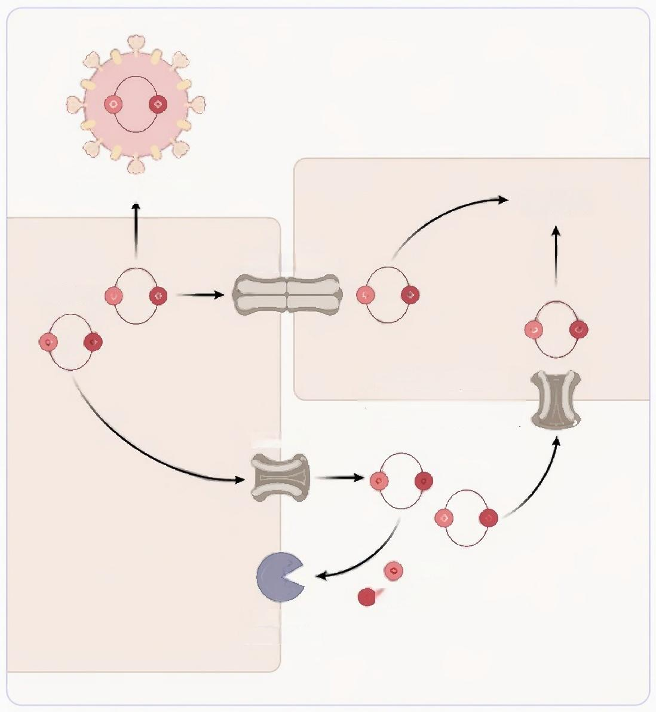
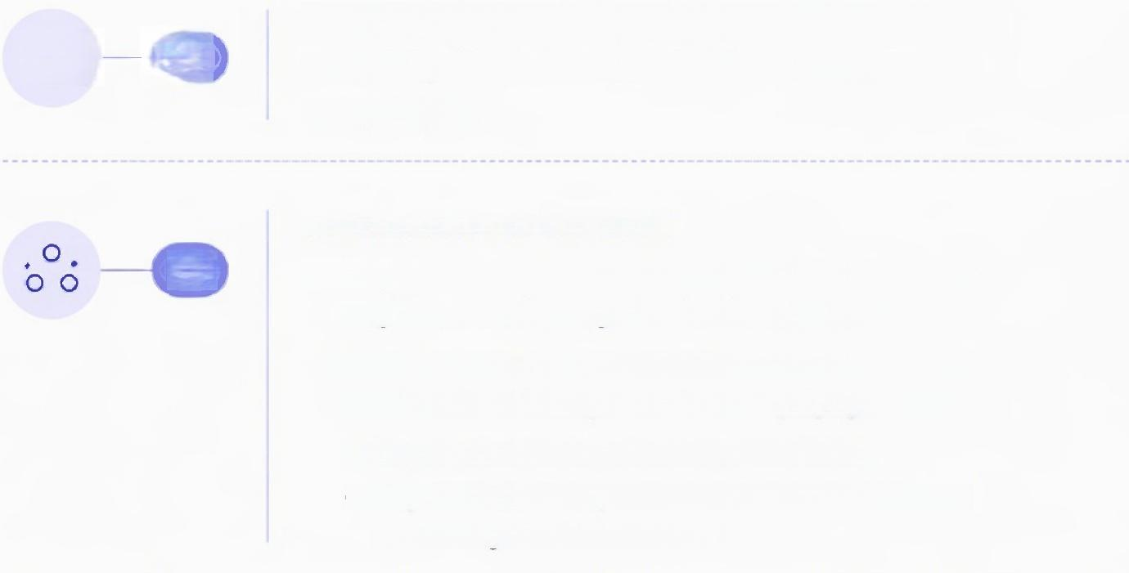


Viral particles _{STING}
Gap junction
cGAMP
cGAMP importer
(SLC19A1,SLC46A2,
LRCC8A/C/E,P2X7R)
ABBC1
GMP
AMP
ENPP1
SMPDL3A
Discussion:Non-Cell-Autonomous
Signaling Expands the Response
米 01 02 | The Principle: The immune response is not confined to the initially stimulated cell.cGAMP acts as a paracrine danger signal. Mechanisms of Transfer: · Gap Junctions: Direct cell-to-celltransfer to immediate neighbors,coordinating a localized tissue response. ● Extracellular Transport:cGAMP can be actively exported into the extracellular space and taken up by bystander cells. ● Export: Mediated by the transporter ABCC1. ● Import: Mediated by solute carriers like SLC19A1 and volume-regulated anion channels. Regulation of Extracellular cGAMP: · Key Concept: The range and duration of extracellular cGAMP signaling must be controlled to prevent excessive inflammation. · Primary Regulator:The ecto-enzyme ENPP1 is the dominant extracellular cGAMP hydrolase,degrading it into inactive GMP and AMP.ENPP1 acts as a critical brake on paracrine STING signaling.
Figure 5: Non-cell-autonomous cGAMP signaling and regulation.
This schematic details the pathways for cGAMP export,import,and extracellular degradation.
Notes:
A remarkable feature of this pathway is its ability to spread the alarm to other cells. cGAMP is not strictly cell-intrinsic. As this figure shows, it can be passed directly to adjacent cells through gap junctions, creating a coordinated neighborhood watch. More profoundly, cGAMP can be actively exported from the cell via transporters like ABCC1, becoming an extracellular danger signal. Other cells can then import this cGAMP using their own set of specific transporters, thereby activating their own STING pathway without ever having sensed DNA themselves. This mechanism is crucial for amplifying the immune response. However, such a potent signal cannot be left unchecked. The body has a built-in brake system: an enzyme called ENPP1, which floats in the extracellular space and rapidly degrades cGAMP. This balance between transport and degradation defines the scale and duration of the non-cell-autonomous response.

Slide 9

















Discussion:The Dichotomy of
CGAS-STING in Health and Disease
cGAS-STING activation as a driver of pathology
Monogenic autoinflammatory syndromes/type l interferonopathies Aicardi-Goutieres syndrome (AGS) Bloom syndrome STING-associated vasculopathy with onset in infancy(SAVI) COPA syndrome Metabolic diseases Obesity linsulin resistance Non-alcoholic steatohepatitis (NASH) Type 2 diabetes/glycaemic control Cardiovascular diseases Cardiac inflammation Myocardial infarction/adverse remodeling | Cancer(pro-tumorigenic activity) Chromosomally unstable/metastatic cancers Neurodegeneration and neuroinflammation Alzheimer's disease/tauopathy Parkinson's disease Huntington's disease Amyotrophic lateral sclerosis (ALS) Aging-associated neurodegeneration Niemann-Pick disease type C Lysosomal storage disorders Experimental autoimmune encephalomyelitis(EAE)
Severe viral immunopathology
COVID-19(severe SARS-CoV-2)
A Double-Edged Sword:The outcome of cGAS-STING activation is highly context-dependent.
Autoimmune diseases
Systemic lupus erythematosus (SLE)
Cutaneous lupus
 | Protective & Beneficial Roles |  | Pathogenic & Detrimental Roles
 | Host Defense:The canonical role in clearing viral,bacterial,and other pathogen infections. Antitumor Immunity: Acute activation in the tumor microenvironment drives dendritic cell activation,T cell priming, and tumor rejection.This is the rationale for STING agonist therapies. Homeostasis: Tonic,low-level signaling helps regulate processes like pain perception and gut tolerance. |  |  | Autoinflammation &Autoimmunity: Aberrant activation due to mutations (e.g.,TREX1,SAVI)or sensing of self-DNA(e.g.,in Lupus)drives chronic inflammation. Neurodegeneration: Chronic STING activation in microglia and neurons contributes to inflammatory damage in diseases like Alzheimer’s, ALS,and Parkinson's. Cancer Progression: In contrast to its antitumor role,chronic tumor-intrinsic STING activation can promote metastasis and create an immunosuppressive microenvironment.
Senescence and aging
Cellular senescence/SASP/inflammaging
cGAS-STING engagement protective/beneficial
Cancer (antitumor immunity) Antitumor immunity (general)
Solid tumors
Lymphoma
Vaccines
Homeostatic regulation
Pain/nociception
Infection(host defense)
Viral infection(DNA&RNA
viruses,retroviruses)
Bacterial infection
(e.g.S.Typhimurium)
Figure 6:Physiology and pathology of endogenous DNA sensing. This chart summarizes the context-dependent effects ofcGAS-STING,categorizing its roles as either protective/beneficial or pathogenic.
Notes:
So, is the cGAS-STING pathway good or bad? The answer, as summarized in this figure, is that it depends entirely on the context. In its beneficial role, it is a lynchpin of our defense against infection. In oncology, its acute activation is highly desirable, as it kickstarts a potent anti-tumor immune response. It even has homeostatic functions in maintaining balance in certain tissues. However, when this pathway is dysregulated, it becomes a major driver of pathology. Chronic, inappropriate activation is at the heart of autoinflammatory diseases like Aicardi-Goutières syndrome and contributes significantly to the pathology of autoimmune diseases like lupus. Furthermore, a growing body of evidence implicates aberrant STING signaling as a key driver of chronic neuroinflammation and neurodegeneration. Even in cancer, what was once a friend can become a foe, as persistent activation can paradoxically promote metastasis. This duality makes the pathway a compelling but complex therapeutic target.

Slide 10







Conclusion:Summary and Future Outlook
02
Contribution:
This review synthesizes a decade of research,framing the cGAS-STING pathway as a central,context-
dependent regulator of immunity, inflammation,and cellular
homeostasis.
03
Future Directions:
01
Summary:
● The cGAS-STING pathway is a
fundamental DNA sensing system that
translates the presence of cytosolic DNA into diverse effector responses.
● Activation is tightly controlled through molecular mechanisms like nucleosomal sequestration to prevent autoimmunity.
● The biological outcome—protective
immunity versus pathological
inflammation—is determined by the
context: the trigger,duration,magnitude, and cellular source of activation.
Dissecting cell-type-specific and
tissue-specific roles of the pathway.
Understanding the molecular switches
that govern the choice between
canonical and non-canonical STING
outputs.
Developing precision therapeutics
(agonists vs.inhibitors)that can be targeted to the right cells at the right time to exploit the pathway's
context-dependent biology.
Notes:
To conclude, the cGAS-STING pathway is the principal sensor for cytosolic DNA, a signal of both infection and cellular distress. Its activity is governed by sophisticated molecular controls, most notably the sequestration of nuclear cGAS to prevent self-reactivity. The most important takeaway from this body of work is that the pathway's function is not fixed; its outcome is critically dependent on context—what triggers it, for how long, and in which cells. This duality makes it a central player in everything from antiviral defense to antitumor immunity, and from autoimmune disease to neurodegeneration. The future of this field lies in achieving a more granular, systems-level understanding. We need to dissect its function with cell-type and temporal precision to understand how to switch its function from pathogenic to protective. This will be essential for successfully translating our deep mechanistic knowledge into the next generation of precision medicines, whether we aim to turn the pathway on to fight cancer or turn it off to quell chronic inflammation. Thank you for your attention. I'm happy to take any questions.

