Slide 1

Frailty Status, Clinical and Functional Outcomes in Cardiac Amyloidosis
A Systematic Review and Meta-Analysis — eClinicalMedicine 2026;98:104059
JIANG, LIM, KHOO, CUDDY, WONG, TAN, GAO, CHEN, DORBALA & KOH
Published by Elsevier Ltd. Open Access under CC BY-NC-ND 4.0.

Slide 2
Background: Why Frailty in Cardiac Amyloidosis?
Cardiac Amyloidosis (CA)
The Frailty Gap
CA is caused by misfolded protein deposits in the myocardium, leading to restrictive cardiomyopathy. ATTR-CM prevalence has surged over two decades due to improved imaging. Reported hospitalization rates reach 61–78% at one year, with median survival of only 3–5 years at diagnosis.
Frailty — a marker of reduced physiological reserve — is increasingly observed in CA but remains poorly characterized. With emerging disease-modifying therapies and potential for frailty reversal, early recognition is critical to guide multidisciplinary intervention and risk stratification.

Slide 3

Study Design & Methods
Study Selection
Database Search
Data Extraction
Meta-Analysis
This review was registered with PROSPERO (CRD420251152212) and conducted per PRISMA guidelines. Frailty had to be pre-defined using validated tools (CFS, FFP, or equivalent). Primary outcome was all-cause mortality, pooled as hazard ratios (HR) or risk ratios (RR) with 95% confidence intervals using inverse-variance random-effects models. Secondary outcomes included hospitalizations, quality of life, 6-min walk distance (6MWD), and disease-modifying treatment prescription. Heterogeneity was assessed using the I² statistic; GRADE framework graded certainty of evidence. Leave-one-out sensitivity analyses and visual funnel plots were performed where applicable.

Slide 4
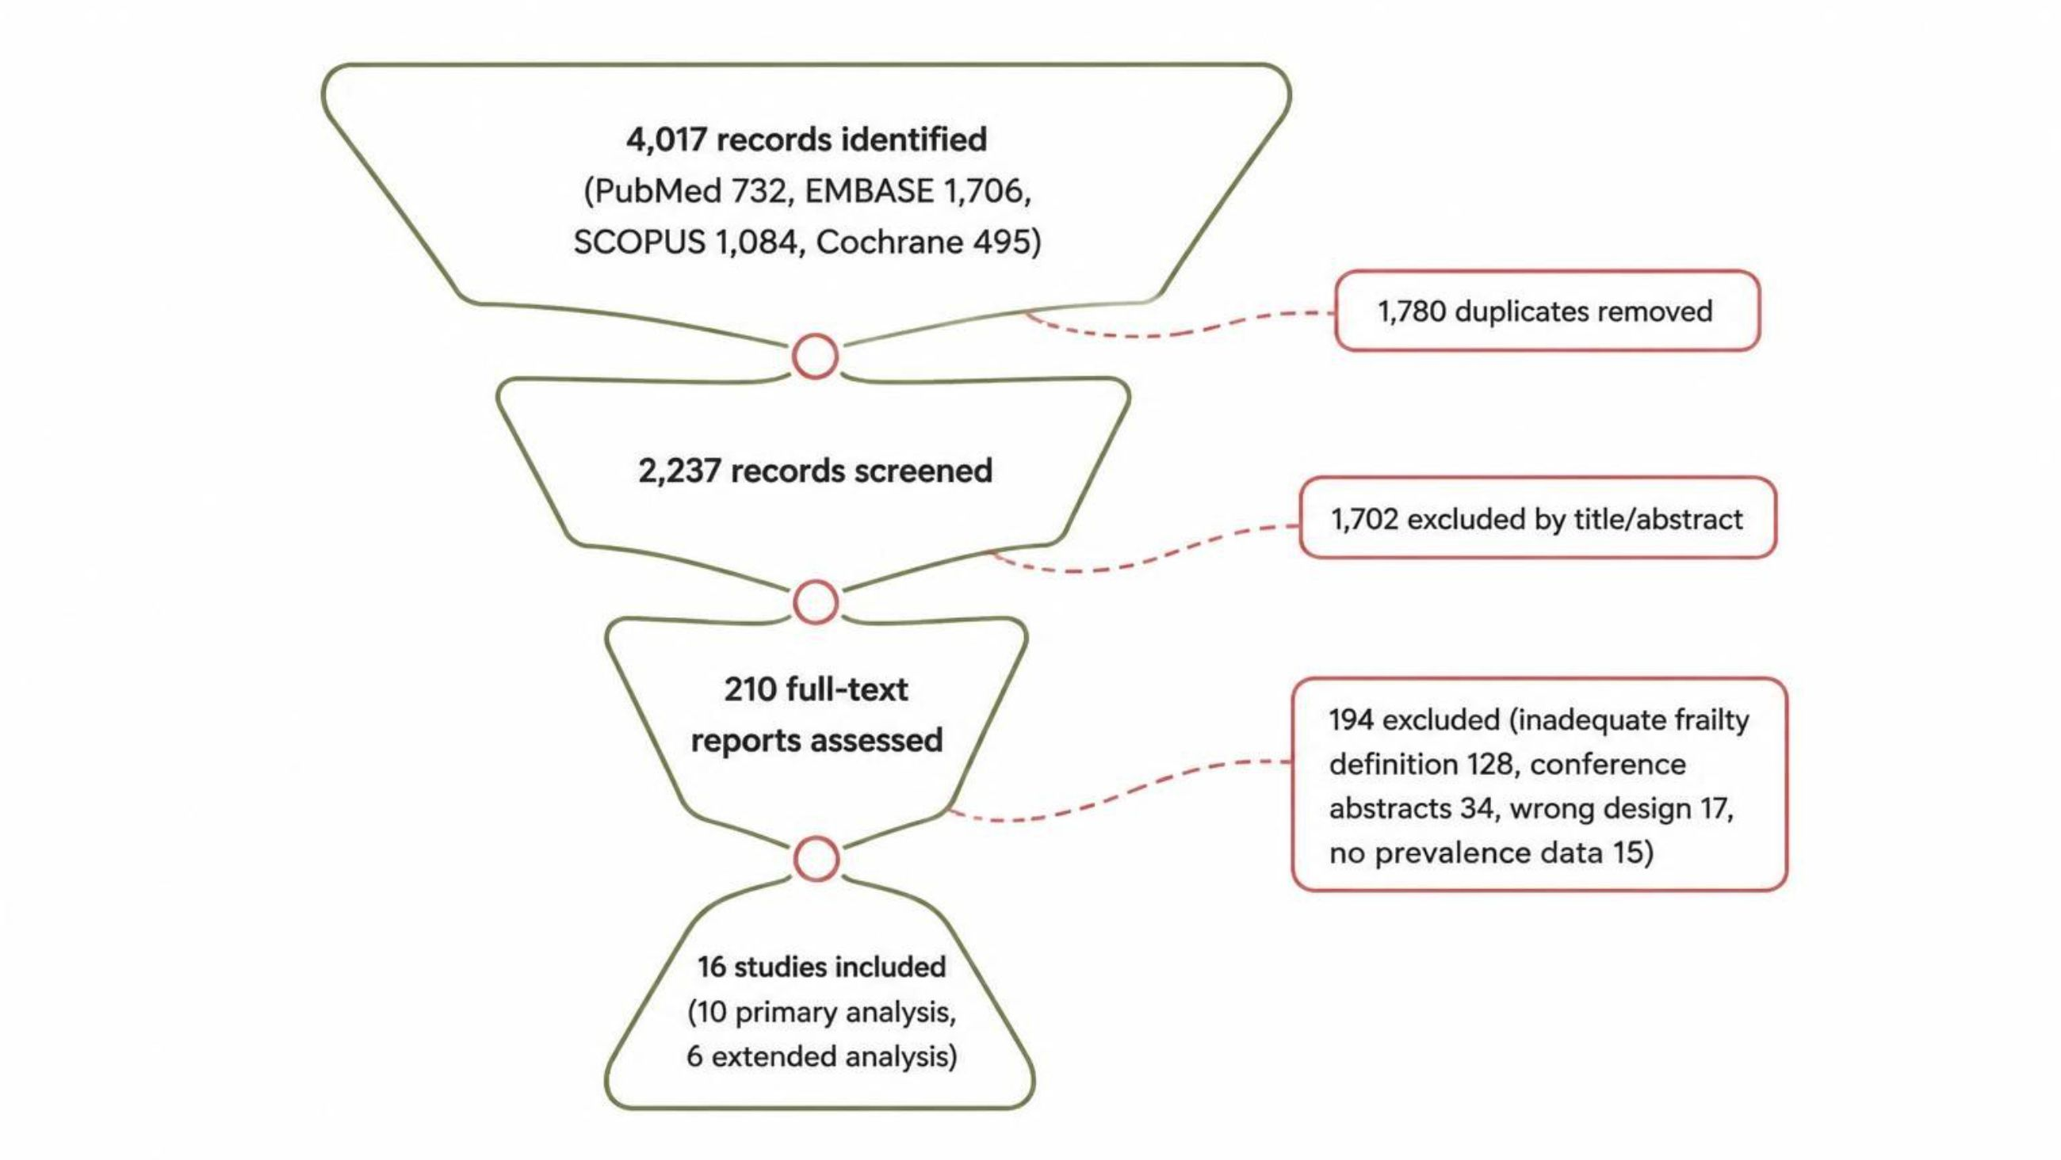
Study Selection: PRISMA Flow
Of 2,237 records screened across four databases, 16 studies comprising 5,565 patients were included — 10 for primary frailty analysis (2,435 patients) and 6 for extended analysis using physical/functional surrogates (3,130 patients). The most common exclusion reason was inadequate frailty definition (n=128). Studies originated from Europe (11), North America (3), South America (1), and Japan (1). Over 95% of patients had ATTR-CM; only one study included AL amyloidosis (58 patients).

Slide 5
Prevalence of Frailty in CA
33.9%
75%
5
Pooled Frailty Prevalence
Highest Single Study
Assessment Tools
826 of 2,435 patients in the primary analysis were classified as frail across all included studies.
Frailty prevalence ranged from 6.7% to 75% depending on assessment tool and cohort characteristics.
CFS, Fried Frailty Phenotype, cumulative deficit index, G8 score, and ECOG-PS were used across studies.
Among CFS studies (4 studies, n=1,311), pre-frailty prevalence was 39.7% and frailty was 16.2%. Among FFP studies (3 studies, n=360), pre-frailty was 38.3% and frailty was 37.2%. No correlation was observed between frailty assessment tool and reported prevalence on visual inspection.

Slide 6
All-Cause Mortality: The Core Finding
Pooled Risk Ratios vs. Non-Frail
Key Robustness Checks
Frailty remained significant after adjustment for age, gender, NAC stage, and disease-modifying treatment (RR 5.60, 95% CI 2.09–15.02, p<0.01)
CFS-only subgroup: pre-frail RR 2.22, frail RR 4.06
Leave-one-out sensitivity: pooled RR range 2.49–3.62 (all p<0.01)
GRADE certainty: moderate for all pooled outcomes
Pre-Frail
Frail
RR 2.22 (95% CI 1.37–3.60, p<0.01)
I² = 49.9%
RR 3.93 (95% CI 2.09–7.40, p<0.01)
I² = 82.7%
Very Frail
RR 8.04 (95% CI 3.01–21.48)
CFS ≥8

Slide 7

6MWD as a Functional Surrogate of Frailty
Three studies (n=2,425) examined 6-min walk distance as a marker of physical frailty. Both baseline and interval changes were prognostically significant.
Baseline 6MWD Below Cutoff
Absolute Decline at 1 Year
Relative Decline at 1 Year
6MWD <350 m or <300 m associated with increased all-cause mortality: HR 2.22 (95% CI 1.15–4.31, p=0.02; I²=57.2%).
A reduction of >35 m in 6MWD at 1-year follow-up predicted mortality: HR 1.80 (95% CI 1.52–2.14, p<0.01; I²=0%).
A reduction of >5% in 6MWD at 1-year follow-up predicted mortality: HR 1.89 (95% CI 1.60–2.23, p<0.01; I²=0%).
Additional surrogates: lower CT-derived skeletal muscle index independently predicted 10-year mortality (HR 0.69 per SD increase, p=0.01); ATTR-CM patients showed abnormal gait patterns vs. controls.

Slide 8




Beyond Mortality: Other Key Outcomes
Cardiovascular Mortality
CFS ≥4 associated with significantly increased CV mortality (HR 10.63, 95% CI 2.71–41.66, p=0.001), remaining significant after multivariable adjustment (HR 8.87, p<0.001). CV hospitalization was not significantly associated.
Quality of Life
Increased frailty via cumulative deficit model was significantly associated with worsening KCCQ-assessed quality of life (β −60.40, p<0.001). Frailty was also associated with poorer NYHA class and disease duration independent of age.
Reduced Treatment Access
Frail patients had ~80% lower odds of receiving disease-modifying therapy (tafamidis), whether defined by FFP (OR 0.182), CFS 6–9 (OR 0.208), or cumulative deficits ≥4 (OR 0.219). Frailty/poor mobility was the most common reason for not initiating (47%) or stopping (61%) tafamidis.

Slide 9
Discussion: Frailty as an Independent Prognostic Factor
What Makes This Study Distinct
Clinical Implications
This is the largest meta-analysis to date: 15 studies, 5,048 CA patients, five validated frailty instruments. Compared to heart failure trials (frailty 11.7–23.8%) and aortic stenosis cohorts (6.1%), ATTR-CM patients show markedly higher frailty at 33.9%. The graded mortality risk persisted across instruments and sensitivity analyses, confirming frailty as an independent determinant beyond chronological aging.
Routine frailty assessment should be incorporated into ATTR-CM care pathways
Recommended: CFS ± 6MWD integrated with NAC staging
CFS stratification: non-frail (1–3), pre-frail (4–5), frail (>5), very frail (>7)
Serial assessment warranted — frailty status may fluctuate over the natural course of ATTR-CM
Treatment decisions should be individualized, not exclusionary, based on frailty

Slide 10

Limitations & Conclusions
Study Limitations
Key Takeaways
Substantial heterogeneity (I² ~50–83%) from diverse frailty tools and variable cut-offs
Only 6 studies reported mortality; fewer than 10 precluded formal publication bias testing
AL amyloidosis under-represented (58 patients, 1 study) — findings apply to ATTR-CM
Cohorts were male-predominant (87.5%); female-specific effects remain under-characterized
Most studies assessed frailty cross-sectionally, limiting temporal and interventional analyses
One in three ATTR-CM patients is frail. Frailty independently predicts 2.2× (pre-frail) to 8.0× (very frail) higher all-cause mortality, poorer functional outcomes, and reduced disease-modifying treatment. Standardized frailty assessment using CFS ± 6MWD, integrated with NAC staging, should be considered in contemporary ATTR-CM care pathways.

