Slide 1
TOP of MIND — IPO Surge: A Red Flag for Markets?
GOLDMAN SACHS TOP OF MIND · JULY 2026
The US IPO market has reopened in a big way in 2026, with issuance already at a record high. But this activity has raised two key concerns: whether it's flashing a late-cycle warning sign and whether the market can digest so much new supply. Ben Snider (GS) argues late-cycle warning signs aren't evident and digestion concerns are overdone. Jay Ritter (U. of Florida) notes high issuance has historically predicted lower returns, but the signal works only "slightly better than chance." Owen Lamont (Acadian) calls an issuance wave one of the "four horsemen" of a bubble — especially alongside a debt surge — but stresses IPO waves can last years and "may mark the beginning of a bubble rather than the end." Key to watch: first-day IPO returns and the AI outlook.

Slide 2
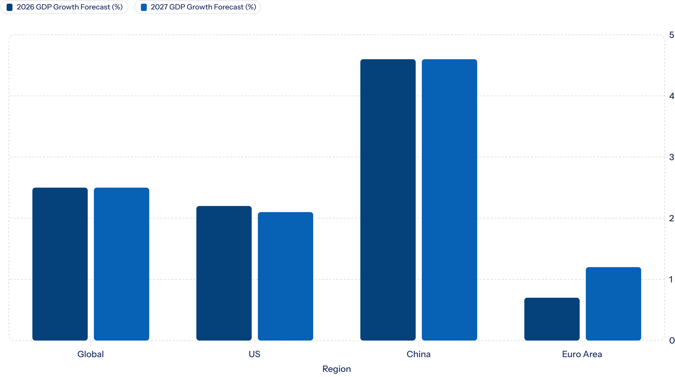
Macro News & Views: Key Datapoints
🇺🇸 US
🇯🇵 Japan
Inflation expected to continue improving, though Iran war re-escalation poses upside risk. Growth to slow in 2H26. Fed expected to hold at 3.5–3.75% for rest of 2026. Labor market resilient but slightly cooler than normal.
FY2027 core CPI forecast raised to 2.3% (from 2.0%) on weaker Yen and higher memory/food prices. Next BoJ hike expected Jan 2027. Shunto base pay rose 3.5% (third consecutive year above 3%).
🇪🇺 Europe
🇨🇳 China / EM
2026 EA GDP growth forecast raised to 0.7% (from 0.5%). ECB expected to hike 25bp in September to 2.5%. EA political risk rising with elections in France, Italy, Spain, Greece in 2027. EA still losing export share to China.
2026 GDP forecast lowered to 4.6% after larger-than-expected 2Q slowdown. Growth powered by exports alone, leaving China vulnerable to global shocks. Stronger easing rhetoric expected at July Politburo. Hungary Euro entry realistic by Jan 2031.
Global growth expected to slow to 2.5% yoy in 2026 amid lingering headwinds from rising energy prices. Global core inflation expected to end 2026 at 2.8%. WATCH THE IRAN WAR: situation remains fluid; closely watching oil flows through Strait of Hormuz.

Slide 3
US IPO Surge: Reasons for Concern… and Comfort
⚠️ Reasons for Concern
✅ Reasons for Comfort
Record issuance: US IPO gross proceeds projected at $225bn in 2026, surpassing prior record of $122bn in 2021
Expiring lockups: ~$720bn in lockup shares set to expire, dramatically increasing public float
Historical signal: Elevated issuance has historically preceded below-average equity returns; median 6m S&P 500 return is just 7% when >75 IPOs occur in a 6-month period
Buyback slowdown: S&P 500 buyback growth has slowed as hyperscalers redirect capital to AI capex
Debt issuance wave: AI-related IG debt issuance exceeds $411bn YTD; Lamont warns combined debt + equity waves would be a negative sign for both markets
Deal count modest: ~60 IPOs YTD vs. 25-year median of ~100/year; 2021 saw 268 IPOs, 1999 saw 394
Valuations reasonable: Median IPO at 5x EV/sales vs. 30-year median of ~4x, well below 9x in 1999 and 7x in 2021
Higher profitability: 43% of 2025 IPOs had positive net income in first public quarter vs. 28% in 1999 and 24% in 2021
Healthy demand: Households are net buyers of equities (unlike during Dot-Com boom); foreign ownership rose from 6% in 1995 to 18% today
Buybacks still robust: ~$1.3tn in gross buybacks expected in 2026, more than offsetting ~$700bn in total equity issuance (~1% of Russell 3000 market cap)
Self-limiting dynamic: IPOs will only come to market as long as demand remains sufficient

Slide 4

Europe, Credit & Hong Kong: Global Issuance Themes
🇪🇺 Europe: A Smaller IPO Rebound
💳 Mind the (Financing) Gap: AI Debt Surge
🇭🇰 Hong Kong's IPO Resurgence
Following a multi-year slowdown (avg. 75 listings, $10bn annually in 2022–2024), Hong Kong staged a powerful rebound: 119 listings raised $37bn in 2025, with 84 companies raising $27bn in H1 2026, on track for ~$60bn full-year. A structural shift toward "Hard Tech" and "New Economy" companies, a surge in A-to-H dual listings (driven by CSRC's "Nine Measures" slowing A-share IPOs), and HKEX's accommodative listing rules underpin the resurgence. IPOs in 2025–2026 generated a median return of ~20% and average of ~60% in the first three months post-listing. Over $400bn in multi-channel demand (dividends, buybacks, Southbound inflows) expected to absorb $110bn in total equity supply.
European equity issuance has picked up — over €200bn raised in 12 months — but represents only 1.7% of market cap, near the long-run 1.4% average. Net supply remains marginally negative. The bigger challenge is lack of domestic equity inflows rather than oversupply. Europe has completed only ~40 IPOs over the past year vs. a normal pace of ~100. M&A is increasingly driven by cross-border flows (50–60% of deal value from foreign acquirers in 2024). GS expects a gradual, selective recovery lagging the US.
GS estimates over $411bn of AI-related IG issuance globally YTD and over $77bn in leveraged finance. Hyperscalers have issued $194bn of IG debt this year vs. $108bn in full-year 2025. Technology now represents 20% of all YTD 2026 USD IG gross supply — a new record — and Tech spreads now trade wide to the broader IG market for the first time since 2010. Issuer concentration and market saturation constraints will become more binding ahead; private lending and project finance expected to fill the gap in 2027+.

Slide 5
Index Rule Changes, Key Forecasts & Archive
New Index Inclusion Rules
Index Provider
Index
Change
Previous
New Rule
Nasdaq
Nasdaq-100
Seasoning
3 months
Top 40 eligible after 15 days
FTSE Russell
Russell US
Seasoning
Quarterly review only
Fast entry after 5 days for large IPOs
CRSP
CRSP US
Float
10% FSO to fast-track
5-day eligibility; 10% FSO or $3.3bn float-adj. cap
S&P Dow Jones
S&P 1500
Seasoning
12 months
Lamont views shorter seasoning periods negatively (impedes price discovery); Ritter sees the current balance as sensible.
Key 2026 Forecasts
Indicator
US
Euro Area
China
Global
GDP Growth (yoy %)
2.2
0.7
4.6
2.5
Core Inflation (yoy %)
2.9
2.6 (peak 4Q)
1.0 (CPI)
2.8
Policy Rate (%)
3.5–3.75
2.5 (peak)
1.40
—
10yr Yield (%)
4.25
3.00
—
—
S&P 500 Target
8,000
—
—
—
USD IG Spread (bp)
82 (4Q)
—
—
—
Top of Mind Archive — Recent Issues
01
02
03
Issue 149 — An AI Job Apocalypse?
Issue 148 — Cracks in Private Credit
Issue 147 — Iran Conflict: How Long, and How Bad?
June 25, 2026
April 27, 2026
March 20, 2026
04
05
Issue 146 — Will AI Eat Software?
Issue 145 — Americas First
March 12, 2026
January 26, 2026
Allison Nathan (Editor) | Jenny Grimberg | Ashley Rhodes | Goldman Sachs & Co. LLC · © 2026 Goldman Sachs

