Slide 1
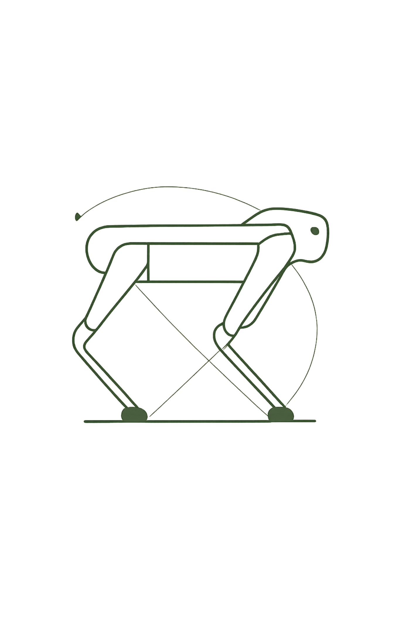
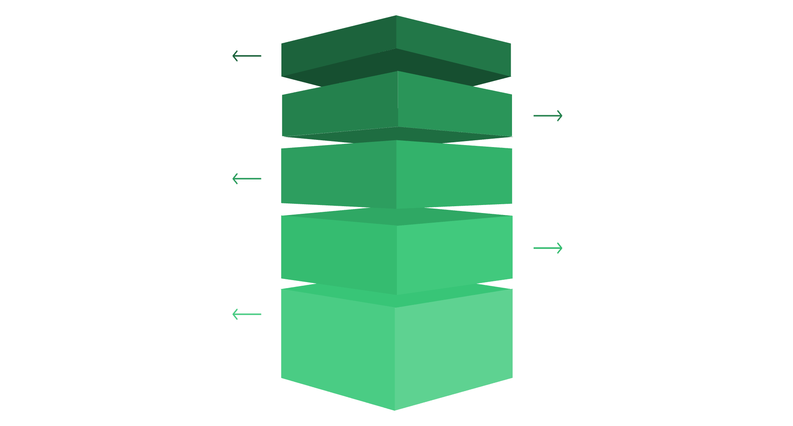
Unitree GO1 — User Manual V1.4
The GO1 is a high-motion performance quadruped robot platform with 12 degrees of freedom (12 high-performance servo motors), force control technology, and an advanced super-sensing system. Overall body weight is 12 kg, making it light and easy to carry. It features the world's first autonomous accompanying function, fisheye binocular camera, ultrasound fusion, and a "God's perspective" APP with multi-eye vision fusion for remote operation beyond visual range.
Base Platform
12 kg lightweight chassis with 12 DOF servos.
Actuation & Control
High-performance motors and force control technology.
Sensing Suite
Fisheye binocular camera and ultrasound fusion sensors.
Autonomy Layer
Built-in autonomous accompanying function for follow mode.
Remote Operation
God's perspective app with multi-eye vision fusion.
2021.12
UNITREE ROBOTICS
DISTRIBUTED BY GÉNÉRATION ROBOTS

Slide 2

Unboxing, Parts & Startup
Unboxing
Key Parts
Place box face-up on flat ground, lift robot out. Untie velcro straps on legs. Components: battery charging dock, charger, joystick, emergency stop button, type-C charger, foot accessories.
Body, dog head, hip joint, thigh, knee joint, lower leg, support pad, foot force sensor, stereo depth camera, ultrasonic sensor, smart battery. Bottom interface panel: Ethernet port, SIM slot, expansion interfaces, external power supply.
Startup
Shutdown
Place robot flat on ground with calves stowed. Insert battery (do not force). Short-press then hold power button 2+ seconds. Robot self-tests and stands up if successful. Connect phone to UnitreeRoboticsGO1-XXX WiFi (password: 00000000).
Ensure robot is in Static Standing State. Hold L2, press A three times (squat→stand→lie). Hold L2, press B twice (prone modes). Then short-press + hold power 2+ seconds. Fold legs and store battery separately if not using long-term.

Slide 3
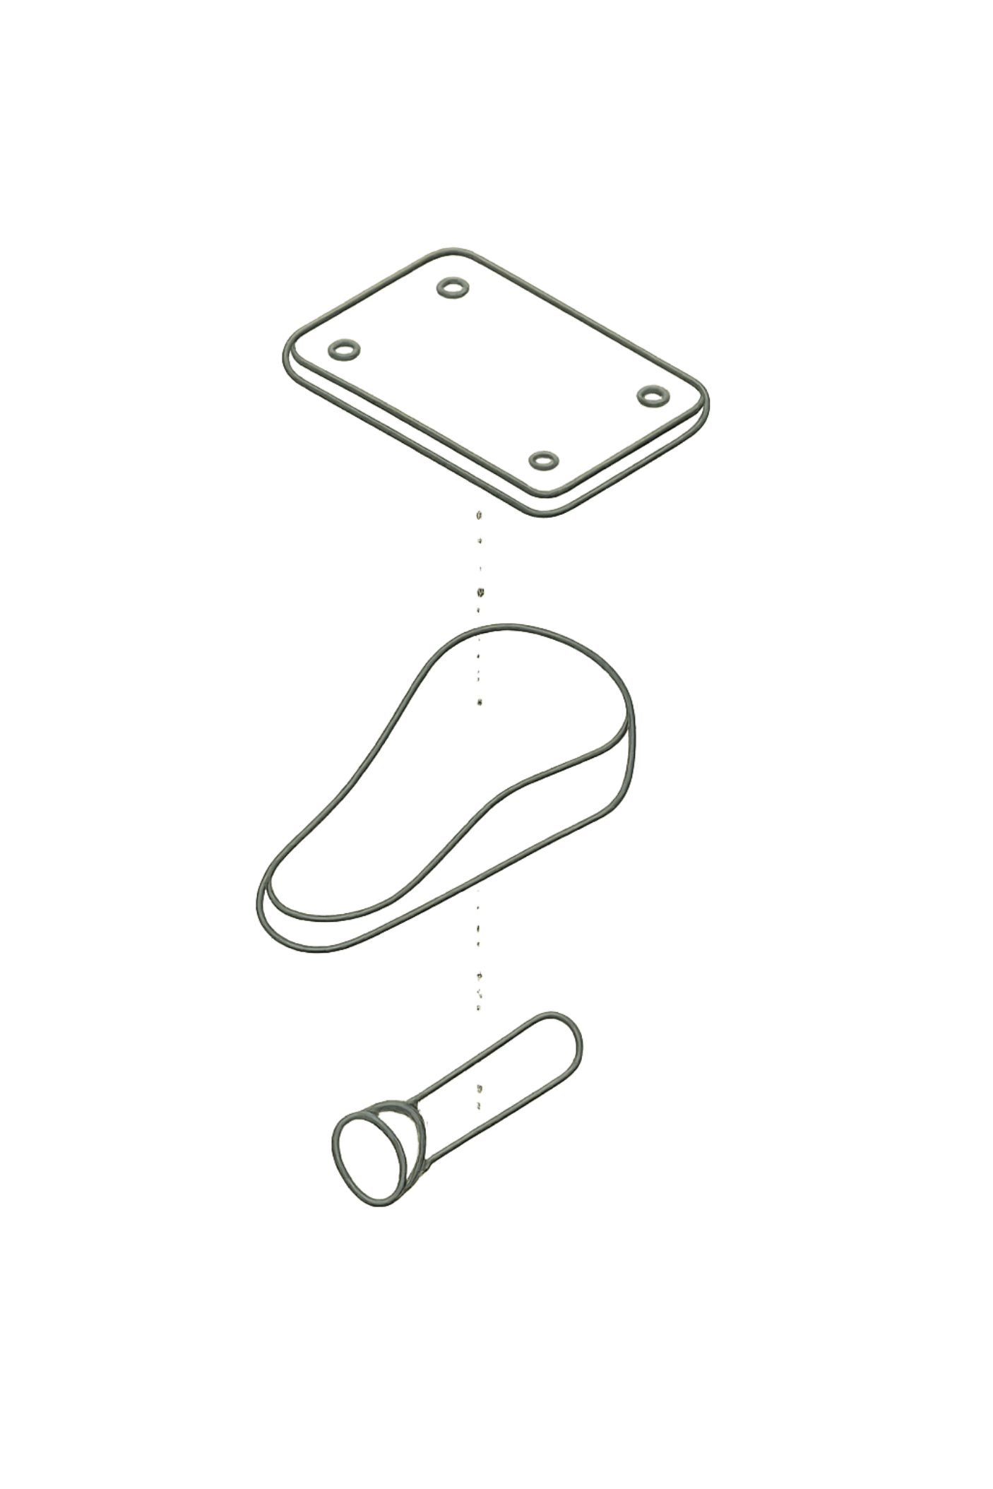
Battery Pack & Foot Assembly
Battery Pack
Foot Assembly
6300 mAh, 21.6V (rated 22.2V), ~1 hour operation. Features: overcharge/over-discharge/short-circuit protection, self-discharge to 65% after 10 idle days, temperature protection (no charge below 5°C or above 55°C). Use only Unitree charger.
LED levels: 4 solid = 87.5–100%; 1 flashing = 0–12.5%. Stop use at 2 bars. Charge only at room temp after use. Store at 22–28°C, discharge to ~65% for transport.
Air-cushioned rubber pads transmit pressure signals to shoulder sensors for terrain adaptation. Consumable — lifespan 2–6 months. Replace when pads show wear, damage, or impact noise increases.
Replacement: Remove 3 foot cap screws, disconnect air needle from rubber trachea, attach new assembly (left/right are directional), tighten screws.

Slide 4
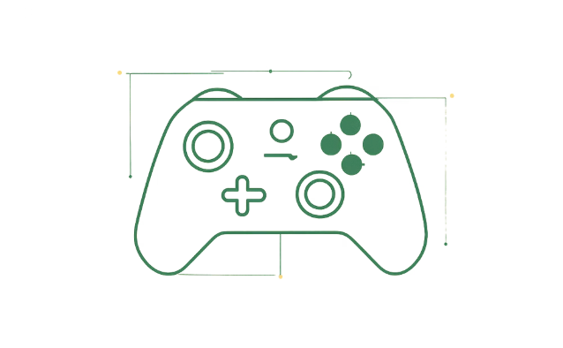
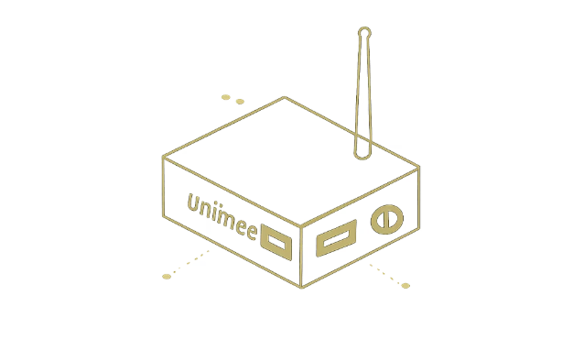
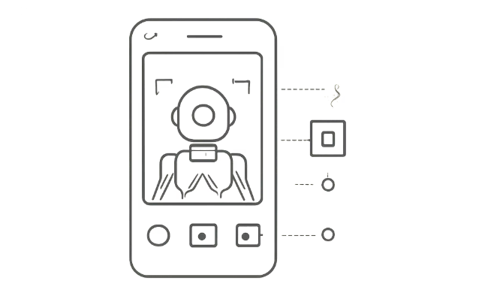
Remote Control & APP
Joystick
Label Controller (Auto-Follow)
APP & Web Interface
Controls 3-axis attitude and position, walking patterns (line, circle, arc, rectangle), crawling, slopes. Bluetooth to phone, 100m+ range, 5h battery. Power: short-press + hold 2s. Calibrate: press F1+F3, rotate sticks full range, press F3 to confirm.
Wear on right waist (0.6–1.2m height). POW: short+long press to power; double-press cycles lie/damp/stand. MOD: 1x = joystick mode; 2x = slow follow (1.5 m/s); 2x again = fast follow (3.0 m/s). B: orientation adjust (0.1 rad/press). Enable via APP: Settings → Peripheral Management → UWB → ON.
UnitreeRobotics (Android/iOS): fisheye camera feed, AI human recognition, SLAM control, real-time system data. Web interface at 192.168.12.1: system management, vision (5 camera feeds), firmware updates, simulator. Note: APP and label controller cannot control robot simultaneously.

Slide 5

Safety, Maintenance & Warranty
⚠ Critical Safety Rules
Warranty & After-Sales
Keep robot in sight, minimum 3m from obstacles, crowds, water
Avoid steps >10cm, slopes >25°, ice, soft ground, dust, water
Operate at 5–35°C; no rain, fog, or electromagnetic interference
Never use emergency brake without official protective frame & rope
Do not push/kick robot — damage not covered by warranty
Stop at 1 battery bar; low power causes falls
Do not lift robot in sport mode; do not use roll function with LiDAR
1-year warranty from receipt date. Void if: private disassembly, non-Unitree parts/battery, improper use, developer mode without protective frame, operation in severe environments (rain, dust, ice, strong magnetic fields), falling damage, water intrusion, or third-party modifications.
Unitree inspects returns; if not covered, customer pays service + return shipping. Backup data before sending — maintenance may cause data loss. Do not return severely damaged batteries.
Official site: www.unitree.cc | Distributor: gr@generationrobots.com
This product is not a toy. By using it, you accept all terms, disclaimers, and safety instructions in this manual. Unitree's liability does not exceed the purchase price.

