Slide 1











Goldman Sachs Global Investment Research
Top of Mind, Issue 150
Data-driven insights.
Global perspective.
Actionable ideas.
Informed decisions.
Independent thinking.
Clear perspective.
Notes:
Good afternoon everyone. Today we're discussing a timely piece from Goldman Sachs' Top of Mind series on the 2026 US IPO surge. Unlike a typical empirical paper with a regression and an identification strategy, this is a data-informed roundtable — three respected market voices interpreting the same set of facts and reaching different conclusions. I think it's a great vehicle for a departmental discussion because it forces us to ask: what does 'good evidence' look like when you can't run a clean natural experiment on market timing? Let's walk through the puzzle, the evidence, the competing interpretations, and then open it up for discussion.

Slide 2












Roadmap
01
The Puzzle:
02
The Evidence:
Record US IPO issuance in 2026
is it a warning sign or a normalization?
Deal counts, valuations, and
supply-demand indicators
03
Three Interpretations:
04
Broader Risk Channels:
Snider (sanguine), Ritter (skeptical of the signal),
Al-related debt issuance,
Europe, Hong Kong
Lamont (cautious)
05
Discussion:
What would change our minds, and what should investors watch?
Notes:
Here's how we'll proceed. First, I'll frame the puzzle: why is a spike in IPO issuance seen as potentially concerning at all. Second, we'll look at the actual data the report marshals — deal counts, dollar volumes, valuation multiples, and supply-demand balances. Third, we'll compare how three experts read the same data differently — this is really the heart of the discussion. Fourth, we'll touch on adjacent risk channels: AI-related corporate debt, and how Europe and Hong Kong's IPO markets are diverging from the US. We'll close with open questions to debate as a group.

Slide 3












Motivation | Record IPO Issuance Reopens
the Late-Cycle Warning Debate
01
Research Puzzle:
02
Why it matters:
After several quiet years, US IPO issuance in 2026
Historically, elevated IPO issuance has preceded
has surged to a record ~$125bn YTD (already
above the prior full-year record of ~$120bn set
in 2021), with full-year volume projected to
exceed $200bn
market downturns (1999 Dot-Com Boom, 2021
growth-stock boom)
Two distinct concerns are conflated in market commentary:
(1) a signaling concern — does high issuance predict poor
forward equity returns? and (2) a mechanical concern
can the market's demand absorb the new supply without
price pressure?
03
Stakes:
04
Contribution of this piece:
If either concern is valid, it has direct
implications for equity strategy, sector
positioning, and how investors should treat
this AI-driven capital-raising cycle
Brings together a quantitative practitioner (Snider), an
academic historian of IPO returns (Ritter), and a skeptical
portfolio manager (Lamont) to stress-test the 'IPO wave =
red flag' narrative against current data
Notes:
Let's start with why this matters. Every time IPO issuance spikes, investors reflexively worry it's a late-cycle signal — think 1999, think 2021. But there are really two separate questions bundled together here. One is a forecasting question: does high issuance statistically predict lower future market returns? The other is a market-microstructure question: is there simply too much new supply for demand to absorb without pushing prices down? The report is valuable precisely because it separates these two questions and brings in three people with different vantage points — a sell-side strategist focused on flow data, an academic who has studied IPO returns for decades, and a portfolio manager who thinks in terms of bubble diagnostics. Let's see what the data actually show before we get to their interpretations.

Slide 4


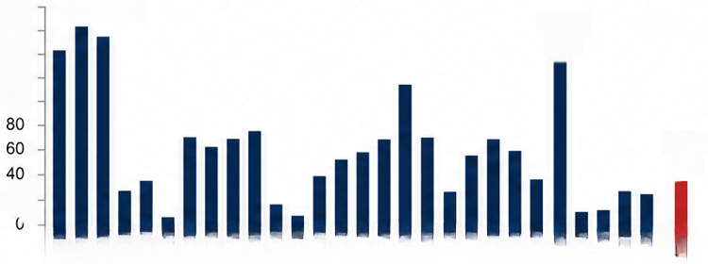





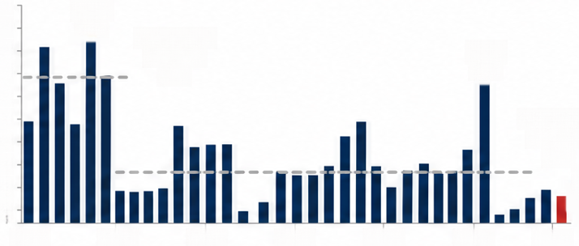



Evidence | Dollar Volume Is at a Record,
But Deal Count Looks Ordinary
1
US IPOs YTD by Year
180
160
140
120
100
1999:168
2021:
139
01
Key descriptive fact: The disconnect between dollar volume and
deal count is central to interpreting whether this is an 'IPO wave'
~60 US companies have IPO'd YTD in 2026 — a >50% YoY increase,
but still close to the 25-year median of ~100 deals/year
2026:
53
Compare: >250 companies went public in 2021; ~400 in 1999 at
the Dot-Com peak
20
2003
2015
2005
2012
2016
2013
2002
2004
2006
2010
2014
2017
2019
2000
2018
2001
2007
2008
2009
2011
2020
2022
2022
2023
2024
Record dollar volume is driven by a handful of very large AI/tech
1998
1999
2025
2026
deals, not broad-based issuance
US IPOs per year
450
400
350
300
250
200
1999
02
Structural context (Ritter): Post-2001 IPO markets have
394
1995-2000
median:
294
structurally shrunk (~100/year vs. >300/year in the 1980s-90s)
due to (1) growth of private capital (VC/PE) reducing the need
to go public, and (2) 'winner-take-most' economics favoring
strategic exit via acquisition over IPO
2021
268
Post-2000
median:
105
150
100
50
0
2026
YTD
03
53
Reading the evidence: Concentration in a few large deals
1995
2000
2005
2010
2015
2020
2025
could reflect either narrow/idiosyncratic issuance (Snider, Ritter)
or the early stage of a broader wave (Lamont)
Fig. shows the number of US IPOs YTD in 2026 versus the same point in prior years,
highlighting the pickup in activity
Fig. shows the number of US IPOs per year over the long run, with 2026's deal count
close to the 25-year median rather than past boom levels
Notes:
This is the single most important empirical fact in the whole piece. If you only look at dollar volume, 2026 looks unprecedented — a new record, above 2021. But if you look at deal count, it's actually unremarkable — around the historical median of roughly 100 deals a year, and nowhere near the 250-400 deals seen in 2021 or 1999. So the 'boom' is really a story about a handful of very large AI-related companies going public, not a broad-based rush of speculative listings. Ritter adds important context: the whole IPO market has structurally shrunk since the early 2000s because private capital — venture and PE — lets companies stay private much longer, and in many tech verticals, being acquired by a strategic buyer beats going public. So when we ask 'is this an IPO wave,' the answer depends heavily on which metric you privilege — and that ambiguity is exactly what our three experts disagree about.

Slide 5

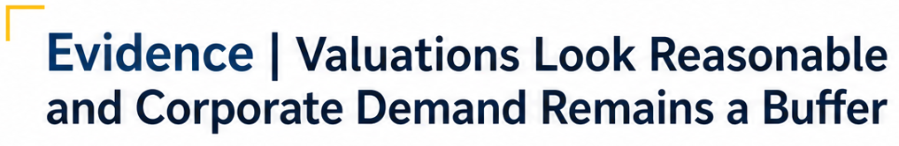
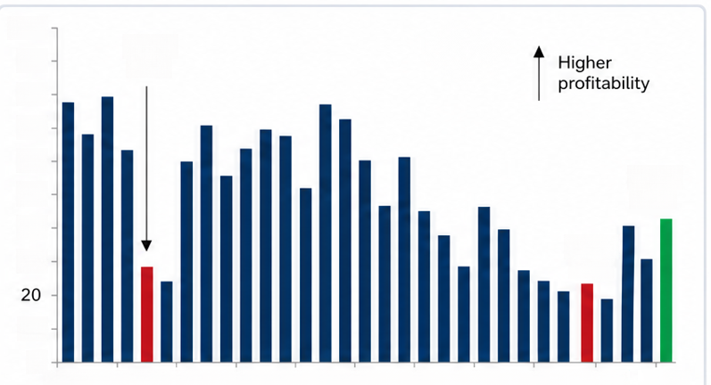





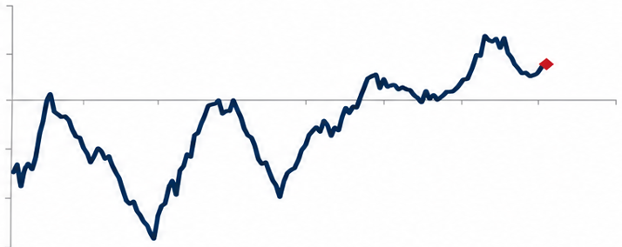




100
1999:
28%
90
80
70
60
2025:
43%
Valuation evidence (not stretched):
50
Median IPO trades at 5x EV/sales in the past
year vs. 30-year median of ~4x, and far below 9x
(1999) and 7x (2021) peak levels
40
30
2021:
24%
10
Macro backdrop indicator:
0
GS's proprietary IPO Barometer (drawdown, CEO
confidence, rate changes, S&P 500 EV/sales,
ISM Manufacturing) signals a 'normal,' not 'boom,'
1995 1998 2001 2004 2007 2010 2013 2016 2019 2
2022
2035
Fig. shows annual US equity issuance and corporate buybacks as
a percent of Russell 3000 market capitalization
environment
10
Supply-side digestion check:
Estimated ~$700bn of 2026 US equity issuance (IPOs,
follow-ons, converts, SPACs) is only ~1% of Russell
3000 market cap — in line with 2015-2019 average,
below 2021 (~1.5%) and the Dot-Com peak (~2%)
5
0
-5
Demand-side offset:
-10
GS projects ~$1.3tn in gross corporate buybacks in 2026,
which would exceed total new equity supply; US
-15
1990
1995
2000
2005
2010
2015
2020
2025
2030
households have shifted from net sellers (Dot-Com era)
to net buyers via ETF/mutual fund inflows and retail
activity; foreign ownership of US equities has risen from
6% (1995) to 18% today
Fig. shows rolling 3-year net household demand for US corporate equities as a
percent of total equity value, showing households have become net buyers
Notes:
Now let's look at the two data points that most directly speak to the 'digestion' worry. First, valuations: the median IPO is trading at about 5 times sales, close to the long-run average and far below the euphoric multiples of 1999 or 2021 — that's evidence against a speculative bubble in pricing. Second, and I think this is the most persuasive quantitative argument in the piece: total equity supply this year, including IPOs and follow-ons, is only about 1% of the Russell 3000's market cap — right in line with the pre-pandemic average. And on the demand side, corporate buybacks alone are projected at $1.3 trillion, which more than offsets total new supply. Households have also flipped from net sellers in the Dot-Com era to net buyers today. So on paper, the supply-demand arithmetic looks manageable — at least for 2026. The caveat, which we'll get to, is 2027, when lockups from this year's IPOs expire and float increases sharply.

Slide 6


















Three Interpretations of the Same Evidence
Jay Ritter
(Academic, skeptical
of the predictive signal)
Ben Snider
(GS, sanguine)
Owen Lamont
(Portfolio Manager, cautious)
No late-cycle warning signs present today;
deal count, valuations, and issuance-to
Confirms high issuance volume predicts
lower future returns, but the signal is weak
correct only ~52% of the time, 'barely
Frames an issuance wave as one of the
'four horsemen' of a market bubble — firms
sell equity when they believe it's overpriced
market-cap ratio all look 'normal,' not 'boom'
better than chance'
We are not yet in a wave by deal count
(an 'IPO drought' persists), but early signs
Notes a self-limiting dynamic: IPOs only
come to market as long as demand is
sufficient, so oversupply is naturally
self-correcting
Digestion fears overblown: US firms recycle
~$1.6tn annually via dividends + buybacks,
dwarfing new IPO proceeds
(large ADR deal, mega-caps pausing
buybacks to issue equity) suggest one
could be forming
Key risk to monitor: first-day returns
as a sentiment gauge, plus the Al
capex/earnings outlook
Cautions against extrapolating historical IPO
underperformance to the current, larger/
Stresses that a bubble's early stage can
look just like this: 'an issuance wave may
mark the beginning of a bubble rather
than the end'
more-profitable cohort
Point of convergence: All three agree we are not yet in a full-blown
'IPO wave' by historical deal-count standards
Notes:
So here's the crux of the debate. All three experts look at the same underlying data and largely agree on the facts — deal count is modest, valuations are reasonable, dollar volume is concentrated in a few AI deals. But they draw very different conclusions. Snider is the most sanguine: he sees a self-correcting market where IPOs will simply stop coming if demand dries up. Ritter, drawing on decades of academic research, agrees the historical 'high issuance predicts low returns' pattern is real but statistically weak — barely better than a coin flip — so he doesn't think it's actionable on its own. Lamont is the outlier in tone, not in facts: he explicitly frames rising issuance as one of the 'four horsemen' of a bubble, arguing companies are smart enough to sell equity when it's overpriced. But even he concedes we're not in a wave yet — he just thinks we might be at the *beginning* of one. This is a good moment to pause and ask the room: whose epistemic framework do you find most convincing — the market-clearing/self-correction logic, the academic base-rate logic, or the bubble-symptom logic?

Slide 7

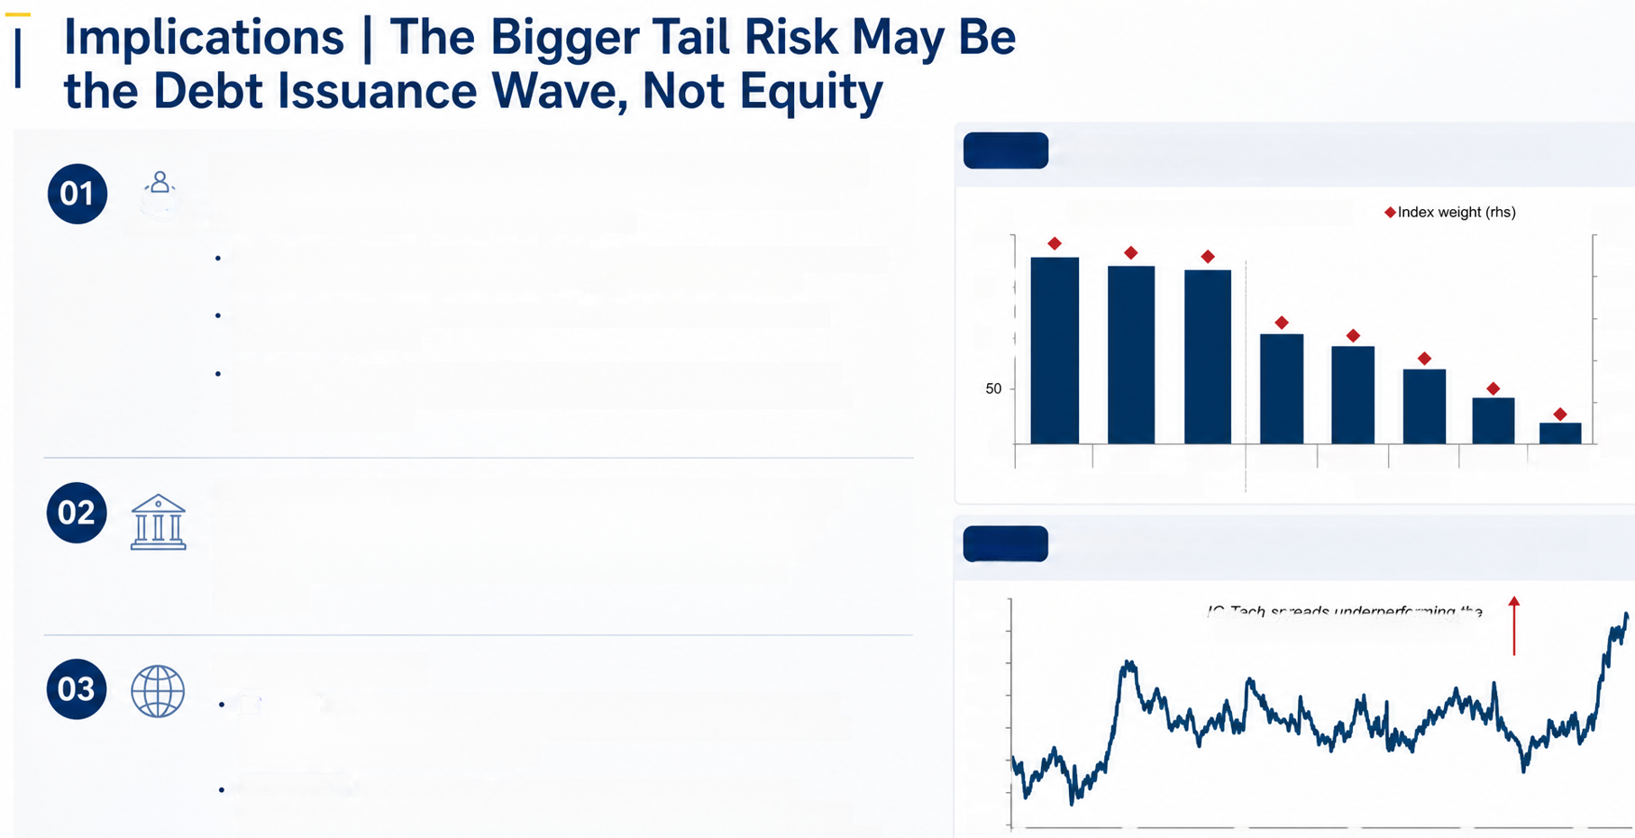

Cross-market amplifier: AI capex is being funded by both equity AND
Fig.1
compares hyperscalers' potential index-eligible debt capacity to
US Banks as a case study for market saturation limits
8.8
debt issuance simultaneously — Lamont notes this combination is a more
negative signal for both markets than either alone
Market value of index-eligible debt (Ihs)
(lhs)
(rhs)
200
2.5
Five largest hyperscalers expected to invest a combined $5.8tn in AI capex (FY2025-30);
consensus capex already consumes the majority of their operating cash flow
2.0
150
Hyperscalers have issued $194bn of IG-rated debt YTD 2026, already exceeding
full-year 2025's $108bn
1.5
100
Technology now represents 20% of all YTD USD IG gross supply (a new record),
and USD IG Tech spreads have moved from historically tight to modestly wide vs
1.0
the broader IG market
0.5
0
JPM
ynam): Scal
Top 3 largest issuers
BAC
AMZN
ORCL
META
hyperscalers
GOOGL
MSFT
0.0
Market saturation constraint (Lynam): Scaling hyperscaler debt
to US Banks' current index share implies only ~$510bn of incremental
debt capacity — far short of the trillions needed, suggesting private
credit and 'project finance' structures will increasingly fill the gap
post-2026
Fig. 2
shows the USD IG Technology sector option-adjusted spread ratio vs
the broader USD IG Corporate Index, now trading modestly wide
1.2
1.1
broader USD IG Corporate Index
Global divergence:
1.0
Europe:
0.9
Equity issuance (~€200bn, 1.7% of market cap) is elevated but net
supply is roughly flat after redemptions — the real constraint is weak domestic
(retail) equity demand, not oversupply
0.8
0.7
Hong Kong:
A structurally different story — a strong resurgence (IPO
0.6
proceeds tracking to $60bn in 2026) supported by deep multi-channel liquidity
(~$400bn), suggesting region-specific dynamics rather than a uniform global 'wave'
0.5
Jan-10
Jan-13
Jan-16
Jan-19
Jan-22
Jan-25
Notes:
One thing I want to highlight before we open discussion is that focusing only on equity IPOs may miss the bigger story. The AI buildout is being financed through both equity and debt simultaneously, and Lamont argues that's the more worrying combination — it suggests the market may be pricing the whole enterprise value of these firms too richly, not just the equity slice. The credit strategist's piece adds a hard numerical constraint: even if you scaled hyperscaler debt levels up to match the largest US banks' share of the investment-grade index, that only gets you about $510 billion of headroom — nowhere near the trillions of financing needed. That's a real capacity constraint we should take seriously. We already see Tech spreads widening relative to the broader IG market this year. And zooming out globally, Europe and Hong Kong show us this isn't a monolithic 'global IPO wave' — Europe's issue is weak domestic demand, not oversupply, while Hong Kong is booming on its own idiosyncratic drivers. This heterogeneity should make us cautious about any single global narrative.

Slide 8

















Discussion, Limitations & Open Questions
Key takeaway
to debate:
Methodological limitations
of this evidence base:
Open Questions
for the group:
What to watch
going forward:
The consensus is 'not yet an IPO
wave, and digestion concerns look
manageable for now' — but this is a
This is an interview/commentary piece,
not a peer-reviewed causal study
conclusions rely on descriptive ratios
and expert judgment, not a formal
identification strategy
Is 'deal count' or 'dollar volume' the more
first-day IPO returns (sentiment gauge),
economically meaningful measure of an
IPO wave, and does it matter for market
the trajectory of the AI capex/earnings
level risk?
narrative, and whether large-cap tech
snapshot judgment, not a structural
What is the right way to weigh a
historically weak (52%) predictive signal
against a plausible economic mechanism
(issuance-as-overvaluation-symptom)?
firms shift further from buybacks to net
equity issuance
prediction
The predictive signal Ritter cites (~52%
accuracy) is explicitly close to a coin flip
raises the question of how much
weight any of these 'indicators' should
really carry
How should the 2027 lockup-expiration
supply shock change our current
risk assessment?
Forward-looking estimates (buyback
totals, 2026 issuance) are GS forecasts,
Does the AI-driven combination of equity
not realized outcomes
and debt issuance constitute a genuinely
new type of warning sign, distinct from
historical IPO booms?
Bottom line for debate
Balance
Uncertainty
Timing
Risk lens
Short-term digestion looks manageable, but the
accumulating supply (especially 2026-2027) and
Al-era financing mix introduce non-trivial risks
that deserve ongoing scrutiny.
Short-term digestion
Weak predictive signal
Al-era financing mix may
signal a new type of
vs. plausible economic
mechanism
and 2027 lockup
expiration supp
Notes:
Let's bring this together for discussion. The overall message of the piece is a qualified 'not yet' — no one thinks we're in a bubble today, but there's real disagreement about how much comfort to take from that. I'd flag some limitations we should be honest about: this isn't a causal study with an identification strategy: it's expert judgment layered onto descriptive statistics, and some of the 'signals' being cited — like Ritter's 52% predictive accuracy — are barely more informative than a coin flip. That raises a good discussion question: how should we weight a statistically weak signal against a plausible underlying economic mechanism, like Lamont's argument that firms strategically time equity issuance to overvaluation? I'd also want to push on whether deal count or dollar volume is the right unit of analysis — they tell very different stories here. And finally, everyone seems to treat 2027 lockup expirations as the real test of the digestion thesis — so maybe our discussion should end there: what would we need to see in the next 12 months to update our own views? I'll open the floor now.

