Slide 1

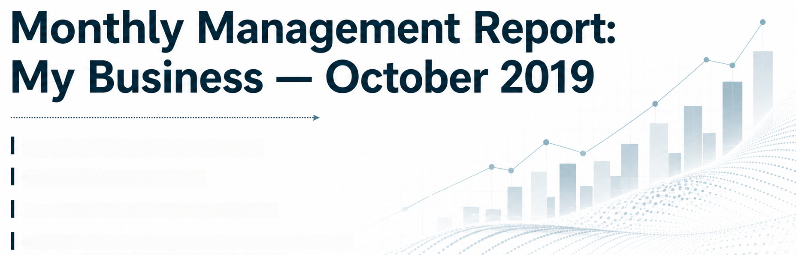



Report Type: Monthly Management Report
Reporting Period: October 2019
Audience: Senior Leadership / Executive Team
Purpose: Review financial performance and define the strategic
direction for sustained business growth
INTEGRATED
SECURE
SCALABLE
Notes:
Good morning. Today I'll walk you through October's management report for the business. But this isn't just a numbers review — my goal is to use this month's results to surface a strategic question the leadership team needs to address, and to propose a concrete direction for driving growth going forward.

Slide 2
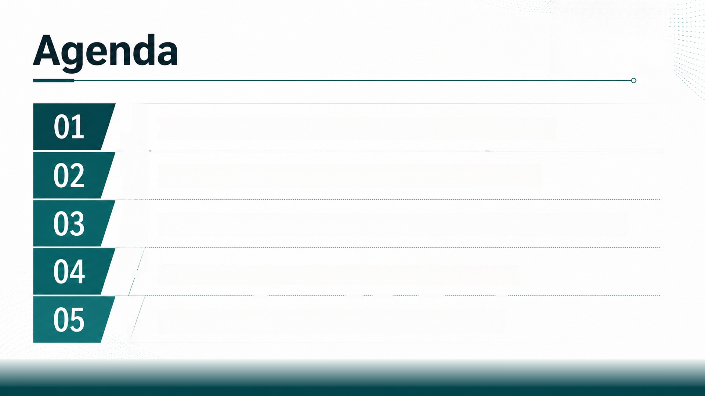












Introduction: The strategic question raised by this month's numbers
Background: How we measure performance — the KPI scorecard
Results: Two contrasting stories — strong margins vs. stalling growth and tight cash
Discussion: Mapping our growth trajectory and cost structure
Conclusion: A proposed strategic direction to drive growth
Notes:
Here's the roadmap for the next few minutes. We'll start with the core question this report raises, ground ourselves in how we measure performance, walk through the key results, discuss what they mean together, and close with a concrete strategic proposal for the executive team to consider.

Slide 3





Introduction: Strong Profits, But a Warning Sign in Revenue
01
Context:
October delivered $97,408 in revenue, $43,000 gross
profit, and $23,442 net income — profitability remains
healthy
02
The Problem:
Revenue fell 6.39% this month and is down 11.08%
versus the rolling 12-month average
03
Objective of this Review:
Determine whether this is a temporary dip or an early
signal that requires a strategic response
04
Why it matters to leadership:
Year-to-date net profit of $70,495 vastly exceeds the $3,903
recorded for all of last year — we cannot afford to let a
growth slowdown erode this progress
Notes:
Let's start with the headline. On the surface, this has been a very strong year — year-to-date net profit is $70,495, compared to just $3,903 for the entire previous financial year. That's a remarkable improvement. But embedded in this month's numbers is a warning: revenue is down 6.4% month-on-month, and it's trending 11% below our rolling twelve-month average. The question for this leadership team is simple: is this a blip, or the beginning of a growth problem that our current profitability is masking?

Slide 4



















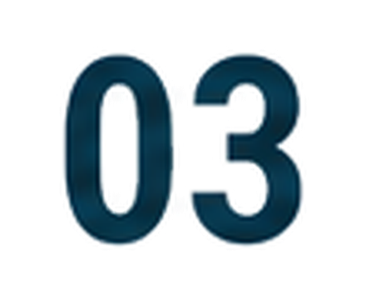













Background: How We Measure Performance
Results
target
trend
importance
01
Framework:
A
Profitability
Every month we track performance
across seven categories — Profitability,
Activity, Efficiency, Asset Usage,
Liquidity, Cash Flow, and Growth
Service Income
$64,019
$14,891
$8,261
$97,408
$69,367
$5,950
$5,000
$88,915
2.9%
7.2%
Consulting Income
High
High
Software Income
Total Revenue
Gross Profit Margin
44.14%
24.01%
24.07%
30.24%
8.22%
8.33%
5.05%
13.12%
13.12%
Medium
Critical
Medium
Profitability Ratio
Net Profit After Tax Margin
V
B
Activity
02
Method:
Activity Ratio
12.57 times
2.00 times
-6.10 times
Critical
Medium
Medium
Accounts Receivable Days *
18 days
40 days
1 days
Each metric is compared against a
target, a trend versus the prior month,
and an importance rating (Critical,
High, Medium, Low)
Accounts Payable Days
Efficiency
Return on Equity
33 days
45 days
5 days
407.08%
301.77%
15%
12.5%
161.33%
98.45%
Critical
Critical
Return on Capital Employed
D
Asset Usage
Asset Turnover
5.99 times
-0.04%
5.00 times
-0.38 times
0.06%
Medium
Working Capital Absorption
Why this matters:
Liquidity
Current Ratio
Quick Ratio
2.00:1
1.00:1
This scorecard lets us separate
strong operational metrics from weak
strategic ones — which is exactly the
tension we see this month
1.96:1
0.40:1
Medium
Cash Flow
Cash on Hand
Net Variable Cash Flow
$137,923
$10,000
44.19%
4.98%
Medium
G
Growth
Revenue Growth
-6.39%
5.7%
9.24%
38.84%
232.54%
-7.44%
30.08%
171.44%
Critical
Gross Profit Growth
EBIT Growth
106.39%
Table shows the KPI Results scorecard across Profitability, Activity, Efficiency, Asset Usage, Liquidity, Cash Flow, and Growth
categories, each measured against target and trend
Notes:
Before diving into the results, it's worth grounding ourselves in how we assess performance. Every month, we score the business across seven dimensions, shown in this table: profitability, activity, efficiency, asset usage, liquidity, cash flow, and growth. Each line has a result, a target, a pass/fail indicator, and an importance rating. As you scan this table, notice something important: most rows show green checkmarks — the business looks strong. But look specifically at the Growth section at the bottom. That's where the red flags concentrate. This is the tension we need to unpack today.

Slide 5


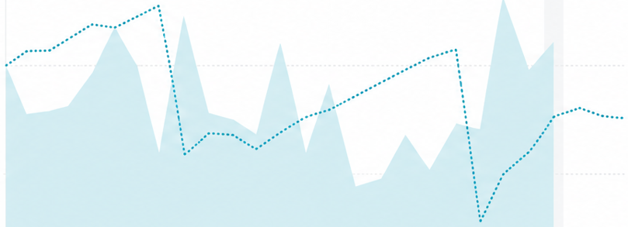














Results: Profitability Is Accelerating
01
Key Finding:
Gross Profit Margin
Gross Profit Margin reached 44.14% this month,
well above both the 30.24% target and the
31.73% rolling 12-month average
44.14%
Gross Profit %
target
%09
target
rolling 12-month average
30.24%
31.73%
02
Trend:
407%
The chart shows margin performance
climbing decisively above target after
several months of underperformance
20%
03
Supporting metrics:
Return on Equity
Return on Capital Employed
Return on Equity of 407% and Return on
Capital Employed of 301% — both far
407%
301%
0%
exceeding target thresholds
target
target
Nov 17 Jan 18 Mar 18 May 18 Jul 18 Sep 18 Nov 18 Jan 19 Mar 19 May 19 Jul 19 Sep 19 Nov 19 Jan 20
15%
12%
04
Interpretation:
The cost structure and pricing discipline
behind this business are fundamentally
with margin percentage now clearing the target line after a period below it
sound and improving
Notes:
Let's start with the good news. This chart tracks gross profit margin against target over more than two years. For much of last year, we were tracking below the dotted target line. This month, margin sits at 44%, well clear of both the 30% target and our historical average. Return on equity and return on capital employed are similarly exceptional. The engine that turns a dollar of sales into profit is working extremely well — that is not the issue we need to solve.

Slide 6

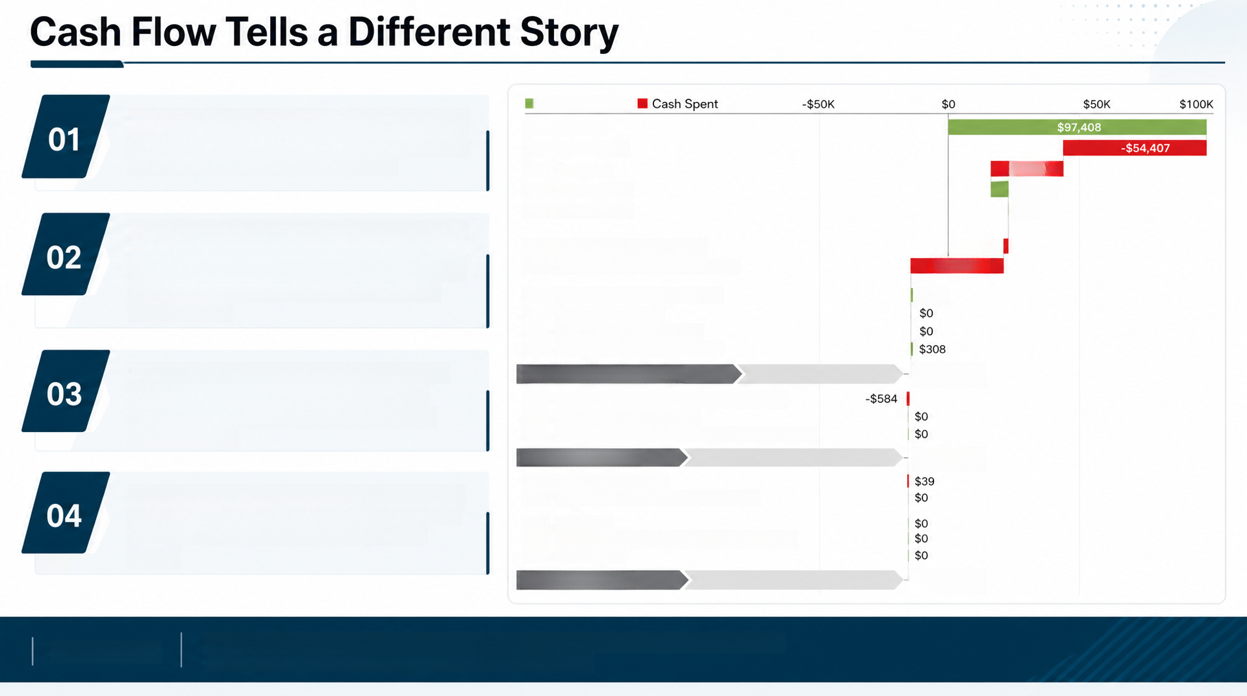
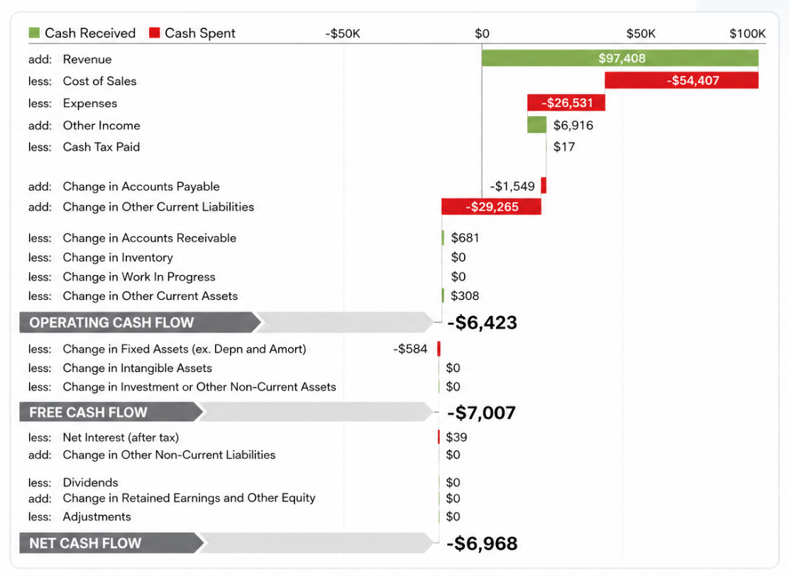
Key Finding: Despite $23,442 in net income, the
business generated -$6,423 in operating cash flow
and -$6,968 in net cash flow this month
Driver: The waterfall shows the gap is driven largely
by a -$29,265 swing in other current liabilities and
a -$1,549 reduction in accounts payable — cash is
being used to settle obligations faster than it is
being collected
Balance sheet buffer: Cash on hand remains
strong at $137,923 and the Quick Ratio is a
healthy 1.96:1, so this is not an emergency
but it is a signal
Implication: Reported profit and cash generation
are currently disconnected, which limits how much
of this profit is actually available to reinvest in
growth
Bottom Line
Strong liquidity provides a buffer, but cash outflows from working-capital obligations are
driving negative cash flow despite solid accounting profit.
Notes:
Now here's the second half of the picture, and it's the more important one for our strategic discussion. This waterfall chart starts with revenue and walks down through costs, expenses, and working capital changes to arrive at cash flow. Notice that operating cash flow, free cash flow, and net cash flow are all negative — roughly minus seven thousand dollars — even though we reported over twenty-three thousand dollars of net income. The gap is driven by large swings in liabilities and payables. We still have a strong cash buffer and liquidity position, so there's no immediate danger. But it tells us that our reported profitability isn't yet converting cleanly into cash we can redeploy for growth.

Slide 7

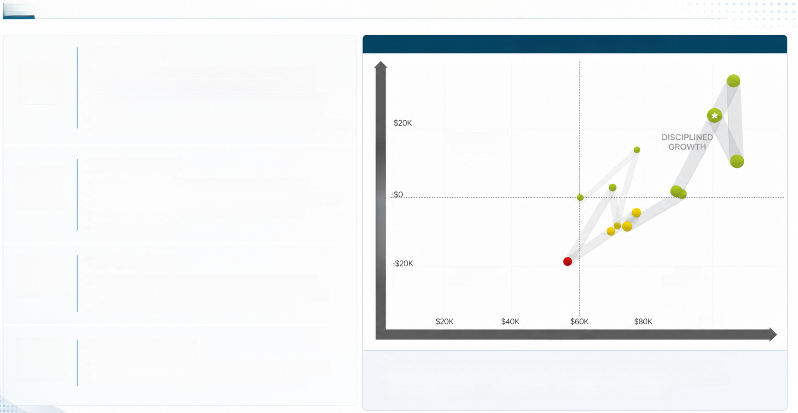

Discussion: Mapping Our Growth Trajectory
Key Finding:
GROWTH FROM Oct 2018 to Oct 2019
01
Our twelve-month trend places the business in the
"Disciplined Growth" quadrant — both revenue and
EBIT have grown over the year — but the most recent
point shows revenue down 6.4% and expenses down
26.6%, a cost-driven rather than growth-driven improvement
OPERATIONAL
EFFICIENCY
Cost structure:
02
Marketing and advertising (agency fees, Google,
Facebook) together represent over $10,000 of monthly
spend — the single largest controllable expense
category after rent
Earnings Before Interest and Tax
03
Interpretation:
We are protecting margin by cutting costs, not by
growing demand — the marketing investment we are
making is not yet reflected in revenue growth
revenue
cost
OVERRUNS
SHORTFALLS
$100K
revenue
04
Strategic tension:
Sustained reliance on cost discipline alone cannot
deliver the growth targets this business needs
Fig. shows the twelve-month growth trajectory plotting Revenue against
Earnings Before Interest and Tax, placing recent results in the "Disciplined
Growth" quadrant despite a monthly revenue decline of 6.4%
Notes:
This chart plots our monthly position over the last year, comparing revenue on the horizontal axis to EBIT on the vertical axis. The trajectory over twelve months has moved us into the 'Disciplined Growth' quadrant, which sounds positive. But look closely at the annotation: this month, revenue dropped 6.4% while expenses fell 26.6%. In other words, this month's improvement came primarily from cutting costs, not from growing the top line. When we look at where the money is going — rent, marketing agency fees, Google and Facebook ad spend — we're still investing heavily in demand generation, but it isn't yet converting into revenue growth. That's the strategic tension at the heart of this report: we can't cost-cut our way to the growth this business is capable of.

Slide 8









A Strategic Direction to Reignite Growth
Summary:
Proposed Strategic Direction — three pillars:
The business has built an excellent
profitability engine — high margins,
strong returns, and a healthy balance
sheet — but revenue growth has
stalled and profit is not yet
converting into cash
01
02
03
Reignite top-line growth
Convert profit into cash
Deploy the balance
sheet strategically
Audit and reallocate the
marketing and agency
spend toward channels
demonstrably driving
Tighten management of
payables and other
current liabilities to close
the gap between reported
net income and operating
cash flow
With $137,923 cash on hand
Impactful Insight:
and a 1.96:1 quick ratio, the
business has the capacity to
fund growth initiatives from
strength rather than waiting
We have already proven we can
run this business profitably
the next strategic priority for
leadership is to prove we can
grow it just as effectively
revenue, rather than
sustaining spend that isn't
moving the growth needle
for revenue to recover
organically
Notes:
So where does this leave us? The business has clearly proven it can operate profitably — margins, returns, and liquidity are all strong. But this month's results expose two vulnerabilities: revenue growth has stalled, and that profit isn't yet flowing through into cash. My proposed strategic direction has three pillars. First, reignite growth by rigorously reviewing where our marketing dollars are going and reallocating toward what's actually driving revenue. Second, tighten how we convert profit into cash by managing payables and liabilities more deliberately. And third — and this is the key mindset shift I want to leave you with — we should see our strong cash position and balance sheet not as a cushion to sit on, but as a war chest to deploy into growth. We've already proven we can run this business profitably. The next chapter for this leadership team is proving we can grow it just as effectively. Thank you.

