Slide 1


Frailty Status, Clinical and Functional
Outcomes in Cardiac Amyloidosis:
A Systematic Review and Meta-Analysis
Authors: Haowen Jiang, Daniel J. Lim, Chun Yuan Khoo, Sarah A. M. Cuddy,
Raymond Wang, Ru-San Tan, Fei Gao, Yucheng Chen,
Sharmila Dorbala, Angela S. Koh
Affiliations: National Heart Centre Singapore; Brigham and Women's Hospital,
Boston; National University Heart Centre Singapore; Duke-NUS
Medical School, Singapore; West China Hospital,
Sichuan University
Published: eClinicalMedicine, 2026
Notes:
Good afternoon everyone. Today I will be presenting a systematic review and meta-analysis examining frailty status and its relationship to clinical and functional outcomes in cardiac amyloidosis, published in eClinicalMedicine in 2026. This work was led by researchers at the National Heart Centre Singapore in collaboration with Brigham and Women's Hospital and other institutions.

Slide 2













Agenda
01
Background: Cardiac amyloidosis and the
emerging role of frailty
02
Research Question & Hypothesis
03
Methods: Systematic review design and
analytic approach
04
Results:
Prevalence of frailty across cohorts
Frailty and mortality risk
Consistency across frailty assessment tools
6-minute walk distance as a functional surrogate
05
Discussion: Frailty as an independent,
multisystem prognostic marker
06
Conclusion, limitations, and future directions
Notes:
Here is the outline for today's talk. I will begin with background on cardiac amyloidosis and frailty, state the specific research question, then walk through the methods used to conduct this meta-analysis. The bulk of the talk will focus on the key results, particularly around frailty prevalence, mortality risk, and functional surrogates like the 6-minute walk distance. I will close with a discussion of the implications and limitations of this work.

Slide 3















Background: Frailty Is an Emerging but Poorly
Characterized Feature of Cardiac Amyloidosis
Known:
Gap in knowledge:
Cardiac amyloidosis (CA) results from misfolded protein deposition
in the myocardium, causing restrictive cardiomyopathy
The prevalence and prognostic effect of frailty
in CA have not been well characterized
Two main types: light-chain amyloidosis (AL) and
transthyretin amyloid cardiomyopathy (ATTR-CM)
Existing data are limited to a few heterogeneous
observational studies with inconsistent frailty
definitions
Incidence of ATTR-CM has risen sharply over the past two decades
due to improved diagnostic imaging (bone scintigraphy, cardiac MRI)
ATTR-CM disproportionately affects older adults; present in ~25%
of autopsies of adults ≥80 years old
Hospitalization rates of 61–78% at one year; median survival
at diagnosis of 3–5 years
New disease-modifying therapies (e.g., tafamidis) have extended
survival, increasing the need for early detection
Frailty—a marker of reduced physiological reserve and inability
to adapt to stressors—commonly co-exists with cardiovascular
disease and worsens prognosis
Notes:
Let's start with some background. Cardiac amyloidosis is caused by deposition of misfolded proteins in the heart muscle, leading to restrictive cardiomyopathy. The two main subtypes are light-chain amyloidosis, or AL, and transthyretin amyloid cardiomyopathy, ATTR-CM. Over the past two decades, the recognized incidence of ATTR-CM in particular has risen sharply, largely due to improved non-invasive diagnostic tools such as bone scintigraphy and cardiac MRI. This disease predominantly affects older adults—it's found in approximately a quarter of autopsies in people over 80. Historically, prognosis has been poor, with high hospitalization rates and median survival of only three to five years after diagnosis. However, new disease-modifying therapies have meaningfully extended survival, which increases the importance of early detection and risk stratification. Frailty—a state of reduced physiological reserve—frequently co-exists with cardiovascular disease and is known to worsen outcomes in other cardiac conditions. Yet in cardiac amyloidosis specifically, the prevalence and prognostic significance of frailty have not been well characterized, and existing studies use inconsistent definitions and tools, making it hard to draw firm conclusions.

Slide 4






Research Question & Hypothesis
01
Central question: What is the impact of frailty on clinical and functional outcomes in
patients with cardiac amyloidosis?
01
02
03
04
02
Specific aims:
Quantify the prevalence
of frailty across cardiac
Determine whether frailty
is independently
Evaluate whether
functional surrogates
Assess the effect of frailty
on hospitalizations, quality
amyloidosis cohorts
associated with all-cause
mortality
of frailty (e.g., 6-minute
walk distance) predict
of life, and prescription of
disease-modifying
treatment
outcomes
03
Working hypothesis: Frailty, whether assessed by validated frailty scales or functional surrogates,
is associated with worse clinical and functional outcomes in cardiac amyloidosis, independent
of age and other clinical covariates
Notes:
Given this gap, the authors set out to answer a central question: what is the impact of frailty on clinical and functional outcomes in patients with cardiac amyloidosis? Specifically, they aimed to quantify how prevalent frailty is across published cohorts, to determine whether frailty independently predicts all-cause mortality, to evaluate whether functional surrogates like the 6-minute walk distance also carry prognostic value, and to assess frailty's effect on hospitalizations, quality of life, and treatment prescription. Their working hypothesis was that frailty—regardless of how it is measured—is associated with worse outcomes, independent of age and other clinical factors.

Slide 5
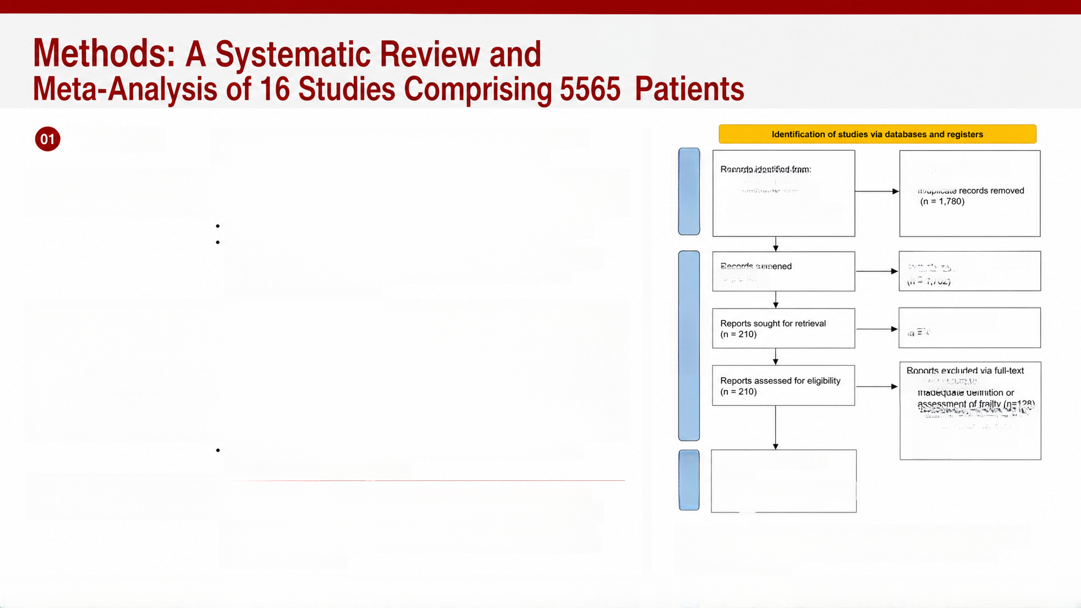
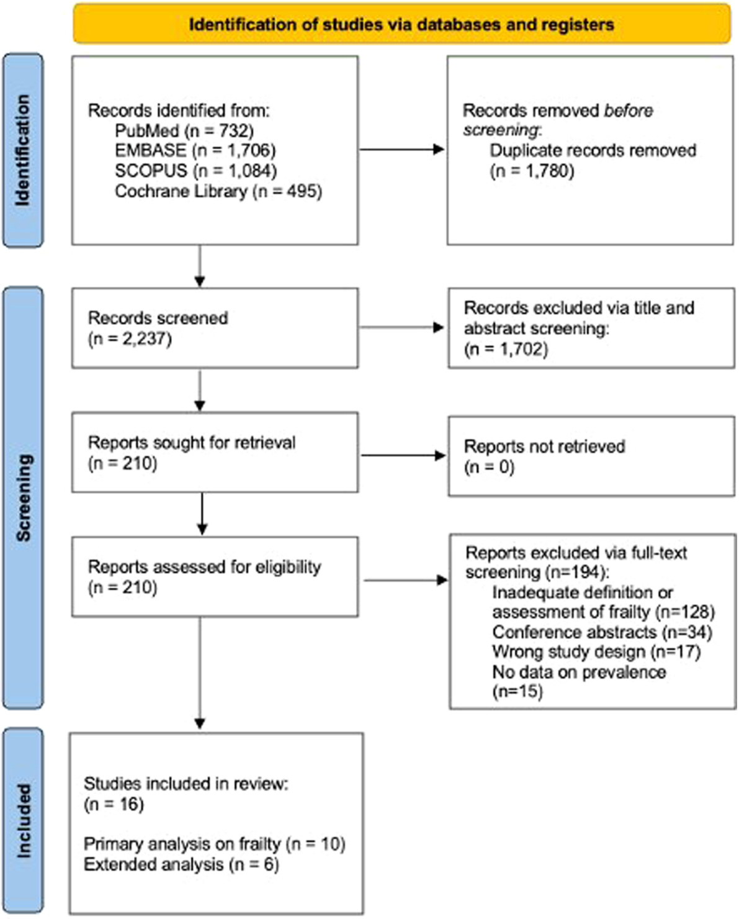







Study design:
Systematic review and meta-analysis, registered on PROSPERO
(CRD420251152212), conducted per PRISMA guidelines
PubMed (n = 732)
Records removed before
screening:
Search strategy:
Four databases searched (PubMed, EMBASE, SCOPUS,
Identification
EMBASE (n = 1,706)
Cochrane Library) for studies published January 2015–April 2026
English-language articles only; conference abstracts excluded
Frailty must have been pre-defined using validated tools
(e.g., Clinical Frailty Scale [CFS], Fried Frailty Phenotype [FFP])
or functional surrogates (6-minute walk distance [6MWD],
gait speed, grip strength)
SCOPUS (n = 1,084)
Cochrane Library (n = 495)
Records excluded via title and
(n = 2,237)
abstract screening:
Study selection:
Reports not retrieved
discrepancies adjudicated by a third senior investigator
screening
Quality assessment:
Newcastle–Ottawa Scale (cohort and modified
cross-sectional versions)
screening (n=194):
Analysis structure:
Primary analysis: 10 studies, 2435 patients with objective
frailty scales (prevalence and mortality)
Extended analysis: 6 additional studies, 3130 patients using
physical/functional surrogates
Wrong study design (n=17)
No data on prevalence
Conference abstracts (n=34)
studies included in the final:
(n = 16)
(n=15)
included
Primary analysis on fraiity (n = 10)
Extended analysis (n = 6)
Statistical approach:
(HR) or risk ratios (RR); heterogeneity via Cochrane Q-test and I²
statistic; dose–response meta-regression using restricted cubic
splines; leave-one-out sensitivity analyses; GRADE framework for
certainty of evidence
Fig. 1: PRISMA flow chart depicting the study selection process,
from 2237 initially identified studies to 16 studies included
in the final analysis
Notes:
Turning to methods. This was a systematic review and meta-analysis, prospectively registered on PROSPERO and conducted following PRISMA guidelines. The investigators searched four major databases for studies published between January 2015 and April 2026, restricting to English-language, peer-reviewed articles. Critically, they required that frailty be pre-defined using a validated tool such as the Clinical Frailty Scale or the Fried Frailty Phenotype, or a recognized functional surrogate such as 6-minute walk distance or gait speed. As shown in this PRISMA flow diagram, from 2237 initially identified studies, 16 met inclusion criteria, totaling 5565 patients. These were split into a primary analysis of 10 studies with 2435 patients using objective frailty scales, and an extended analysis of 6 additional studies with 3130 patients using functional surrogates. Study quality was assessed with the Newcastle-Ottawa Scale, and pooled effect estimates were generated using inverse-variance random-effects models, with heterogeneity assessed via the I-squared statistic and robustness confirmed through leave-one-out sensitivity analyses.

Slide 6
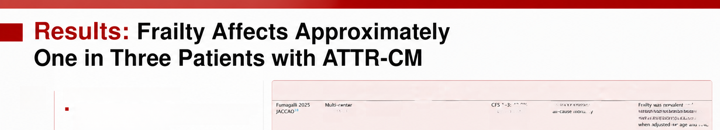

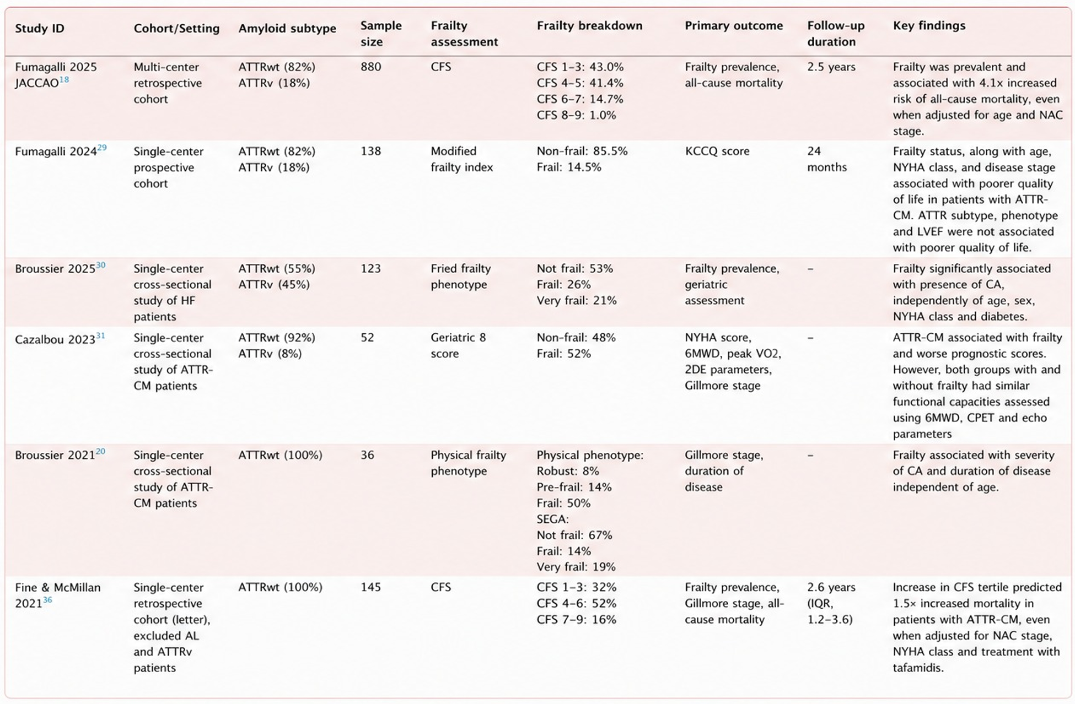


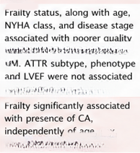

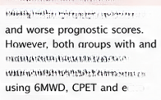

















01
Cohort characteristics:
Study ID
Cohort/Setting
Amyloid subtype
Sample
size
Frailty
assessment
Frailty breakdown
Primary outcome
Follow-up
duration
Key findings
16 studies; mostly ATTR wild-type patients, with 7 studies
including some ATTRv patients; only 1 study included
AL amyloidosis (58 patients)
retrospective
Cohort
ATTRwt (82%)
ATTRv (18%)
880
CFS
CFS 4-5: 41.4%
CFS 6-7: 14.7%
CFS 8-9: 1.0%
frailty prevalence,
2.5 years
associated with 4.1x increased
risk of all-cause mortality, even
Fumagalli 202429
Single-center
prospective
Cohort
ATTRwt (82%)
ATTRv (18%)
138
Modified
frailty index
Non-frail: 85.5%
Frail: 14.5%
KCCQ score
24
stage.
Mean age ranged from 72 to 84 years; 87.5% male
Five different frailty tools used: Clinical Frailty Scale (CFS,
months
5 studies), Fried Frailty Phenotype (FFP, 3 studies),
cumulative deficit frailty index (2 studies), Geriatric 8 score
(1 study), ECOG Performance Status (1 study)
of life in patients with ATTR-
Broussier 202530
with poorer quality of life.
Single-center
cross-sectional
study of HF
Patients
ATTRwt (55%)
ATTRv (45%)
123
Fried Frailty
Phenotype
Not frail: 53%
Frail: 26%
frailty prevalence,
Very frail: 21%
Geriatric
assessment
NYHA class and diabetes.
ATTR-CM associated with frailty
02
Key finding:
Cazalbou 2023³1
Single-center
cross-sectional
ATTRwt (92%)
ATTRv (8%)
52
Geriatric 8
score
Non-frail: 48%
Frail: 52%
NYHA score,
Pooled frailty prevalence: 33.9% (826/2435 patients
classified as frail)
CM patients
Gillmore stage
without frailty had similar
Prevalence ranged widely across studies, from 6.7% to 75%,
depending on tool and cutoff used
functional capacities assessed
Broussier 202120
ATTRwt (100%)
36
Physical frailty
Phenotype
Physical phenotype:
Robust: 8%
Gillmore stage,
duration of
disease
parameters
Frailty associated with severity
No clear correlation observed between the specific frailty
tool used and reported prevalence
cross-sectional
study of ATTR-
of CA and duration of disease
CM patients
Frail: 50%
SEGA:
Not frail: 67%
Frail: 14%
03
Interpretation: Frailty is common in ATTR-CM
Fine & McMillan
Single-center
retrospective
ATTRwt (100%)
145
CFS
2.6 years
Increase in CFS tertile predicted
1.5× increased mortality in
populations, but reported prevalence is highly
sensitive to the assessment instrument and
cutoffs applied
cohort (letter),
excluded AL
and ATTRv
Patients
CFS 7-9: 16%
cause mortality
1.2-3.6)
patients with ATTR-CM, even
NYHA class and treatment with
Table 1 provides an overview of key baseline characteristics, frailty assessment tools, and findings across the 16 included studies
Notes:
Let's start with the baseline findings. Table 1 summarizes the 16 included studies, most of which enrolled wild-type ATTR patients, with only a handful including hereditary ATTR variant carriers and just one study including AL amyloidosis patients. Mean ages ranged from 72 to 84 years, and the cohorts were predominantly male at nearly 88 percent. Five different frailty assessment tools were used across studies, most commonly the Clinical Frailty Scale. Pooling across the primary analysis of 2435 patients, 826 were classified as frail—a pooled prevalence of 33.9 percent, or roughly one in three patients. However, reported prevalence varied enormously across individual studies, from as low as 6.7 percent to as high as 75 percent, and this variation did not correlate clearly with which frailty tool was used. This tells us that frailty is common in this population, but that the specific instrument and cutoff chosen substantially affects the reported rate.

Slide 7

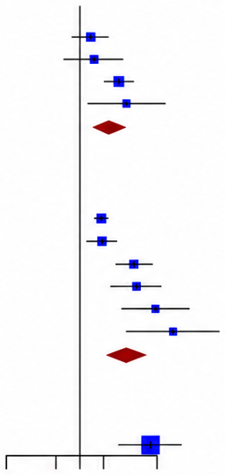



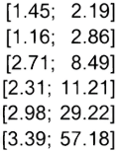



Both Pre-Frailty and Frailty Are Associated with
a Graded Increase in All-Cause Mortality
01
Experimental approach:
Study
logRR SE(logRR)
Risk Ratio
RR
95-%%1
Pooled 6 studies (2141 patients) reporting
all-cause mortality outcomes stratified by frailty status
(robust vs. pre-frail vs. frail vs. very frail)
Pre-Frailty
Takahashi 2021
0.3646
0.4593
1.1394
1.3429
0.2864
0.4583
1.44
1.58
3.12
3.83
2.22
Fumagalli 2025 CIRCHF
Fumagalli 2025 JACCAO
Fine 2021
0.2216
0.5924
Random effects model
[1.37–3.60]
02
Key finding:
Heterogeneity: I² = 49.9%, p = 0.1121
Pre-frailty: RR 2.22 (95% CI 1.37–3.60, p < 0.01), I² = 49.9%
Frailty: RR 3.93 (95% CI 2.09–7.40, p < 0.01), I² = 82.7%
After adjustment for age, gender, NAC stage, and disease
Frailty
Milani 2025
0.5766
0.1053
1.78
1.82
4.80
5.09
9.33
13.92
Takahashi 2021
0.5988
1.5684
1.6267
2.2332
2.6333
0.2302
0.2912
0.4032
0.5826
0.7208
modifying treatment (2 studies, 1019 patients): frailty RR 5.60
Fumagalli 2025 JACCAO
(95% Cl 2.09–15.02, ρ < 0.01)
Fine 2021
Shahi 2024
03
Dose-response relationship:
Random effects model
3.93
[2.09–7.40]
Heterogeneity: I² = 82.7%, p < 0.0001
Restricted cubic spline modeling showed a monotonic increase
in mortality risk with rising CFS score, though the linear trend
(RR 1.18 per point) did not reach statistical significance
(95% Cl 0.80-1.73, p = 0.44)
very frail
Fumagalli 2025 JACCAO
2.0842
0.5015
8.04 [3.01; 21.48]
0.1
0.5 1 2
10
04
Lower Mortality Higher Mortality
Interpretation:
A clear risk gradient exists across the frailty spectrum, and the
association with mortality persists after adjustment for clinical
covariates, supporting frailty as an independent prognostic factor
Fig. 2: Forest plot of all-cause mortality in patients with cardiac amyloidosis, stratified
into pre-frail, frail, and very frail groups compared to robust patients. All frailty
categories showed significantly increased mortality risk relative to robust status
Notes:
This is the central finding of the paper. Six studies with a combined 2141 patients reported all-cause mortality stratified by frailty status. This forest plot shows the pooled risk ratios: each row represents a study or subgroup comparison, with the horizontal line indicating the 95% confidence interval and the box size reflecting study weight. Compared to robust patients, pre-frail patients had more than double the mortality risk—a risk ratio of 2.22—while frail patients had nearly a four-fold increase, at 3.93. When restricted to two studies that adjusted for age, gender, disease staging, and treatment use, the association actually strengthened, with a risk ratio of 5.60. A dose-response analysis using the Clinical Frailty Scale as a continuous variable showed a steadily rising mortality risk with worsening frailty, even though the linear trend itself did not reach statistical significance due to wide confidence intervals. Altogether, this establishes a clear, graded relationship between frailty severity and mortality risk in this population.

Slide 8








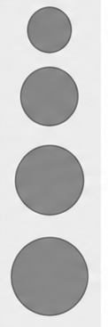









Mortality Risk Is Consistent Across
Different Frailty Assessment Tools
Experimental approach: Bubble plot visualizing mortality
disease-modifying treatment
risk ratios against the specific frailty toolset used in each study,
stratified by disease-modifying treatment usage
Shahi 2024
<50% at baseline
a
>50% at baseline
Not mentioned
Sensitivity analyses:
Restricting to CFS-only studies: pre-frailty RR 2.22 (95% CI
1.37–3.60); frailty RR 4.06 (95% CI 2.08–7.94, p < 0.01)
Fine & McMillan 2021
No. patients
Leave-one-out analysis: pooled RR remained within
2.49–3.62 (all p < 0.01) regardless of which study was omitted
200
Risk Ratio of All-cause Mortality
Excluding satisfactory-quality studies: pooled RR 3.88
Fumagalli 2025 CIRCHF
400
(95% Cl 1.95–7.71)
Fumagalli 2025 CIRCHF
GRADE certainty of evidence: moderate for all pooled
mortality outcomes
Fumagalli 2025 CIRCHF
Fumagalli 2025 JACCAO
600
Key finding: No obvious visual correlation between frailty
tool used and mortality risk, even after accounting for
800
treatment status
Milani 2025
Interpretation: The prognostic signal of frailty is robust and
generalizable across different measurement instruments, not
an artifact of any single tool
Clinical frailty scale
Cumulative deficit model
ECOG
Physical Frailty Phenotype
Frailty Assessment Tools
Fig. 3: Bubble plot showing mortality risk ratios plotted against the frailty toolset used in each study,
stratified by disease-modifying treatment usage, with no clear visual association between toolset
and mortality rate
A91329, B26613, A86605
Notes:
A natural concern with pooling studies that use different frailty instruments is whether the results are simply an artifact of the tool chosen. This bubble plot addresses that concern directly: each bubble represents a study, plotted by frailty toolset used on the x-axis and mortality risk ratio on the y-axis, with bubble size reflecting sample size and color indicating treatment usage. As you can see, there is no obvious pattern linking a specific tool to a systematically higher or lower risk estimate. This was further confirmed through several sensitivity analyses: restricting to only studies using the Clinical Frailty Scale gave very similar results; a leave-one-out analysis, removing one study at a time, kept the pooled risk ratio stable between 2.49 and 3.62; and excluding the two lower-quality studies gave a consistent risk ratio of 3.88. The GRADE framework rated the overall certainty of this evidence as moderate. Together, this tells us the prognostic effect of frailty is robust and not dependent on any single measurement approach.

Slide 9


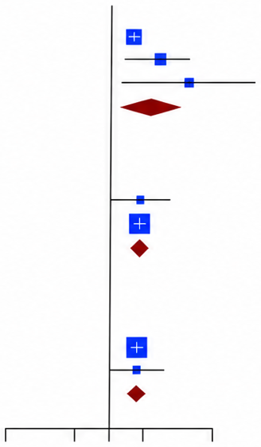














6-Minute Walk Distance, a Functional Surrogate of
Frailty, Independently Predicts Mortality
Experimental approach:
Study
logHR SE(logHR)
Hazard Ratio
HR
95%-Cl
Extended analysis pooling 3 studies (2425 patients)
examining baseline 6-minute walk distance (6MWD),
and 2 studies (1308 patients) examining 1-year
interval change in 6MWD
Baseline 6MWD
loannou 2024
Poledniczek 2025
Romero 2024
Random effects model
0.4318
1.0688
0.0825
0.4197
0.8238
1.54 [1.31; 1.81]
2.91
[1.28; 6.63]
1.7527
5.77
2.22
[1.15–4.31]
Key findings:
Heterogeneity: I² = 57.2%, p = 0.0966
Baseline 6MWD below cutoff (<300–350 m):
HR 2.22 (95% CI 1.15–4.31, p = 0.02), I² = 57.2%
>5% reduction
Absolute reduction in 6MWD >35 m over 1 year:
HR 1.80 (95% CI 1.52–2.14, p < 0.01), I² = 0%
Poledniczek 2025
loannou 2024
Random effects model
0.6318
0.6366
0.3286
0.0874
1.88 [0.99; 3.58]
1.89 [1.59; 2.24]
1.89 [1.60; 2.23]
Relative reduction in 6MWD >5% over 1 year:
HR 1.89 (95% CI 1.60–2.23, p < 0.01), I² = 0%
Heterogeneity: I² = 0%, p = 0.9888
Supporting evidence:
>35m reduction
loannou 2024
Poledniczek 2025
0.5878
0.6049
0.0901
Gait analysis showed ATTR-CM patients walked slower,
with shorter/narrower strides and greater variability
compared to matched healthy controls
0.3251
1.83 [0.97; 3.46]
1.80 [1.52; 2.14]
Random effects model
Heterogeneity: I² = 0%, p = 0.9596
Interpretation:
0.1
0.5
1
10
Both a single low baseline 6MWD and a decline in 6MWD
over time serve as low-cost, objective, non-invasive
markers of frailty-related mortality risk, complementing
formal frailty scales
Lower Mortality
Higher Mortality
Fig. 4: Forest plot of all-cause mortality outcomes stratified by baseline 6-minute walk distance and
by interval (1-year) change in 6MWD; both low baseline distance and decline over time were
associated with significantly increased mortality risk
Notes:
Beyond formal frailty scales, the authors also examined the 6-minute walk distance, a simple, low-cost functional test, as a surrogate marker of frailty. This forest plot presents the pooled hazard ratios for mortality. The top portion shows that patients with a baseline 6MWD below 300 to 350 meters, depending on the study's cutoff, had more than double the mortality risk, with a hazard ratio of 2.22. The bottom portion shows interval change over one year: both an absolute decline of more than 35 meters and a relative decline of more than 5 percent were each associated with roughly an 80 to 90 percent increase in mortality risk, and notably, heterogeneity for these interval-change analyses was zero percent, indicating very consistent findings across studies. This is further supported by gait analysis data showing that ATTR-CM patients walk more slowly and with greater variability than healthy controls. The takeaway is that 6MWD—both a single measurement and its trajectory over time—provides an accessible, objective way to capture frailty-related risk without requiring a formal frailty questionnaire.

Slide 10

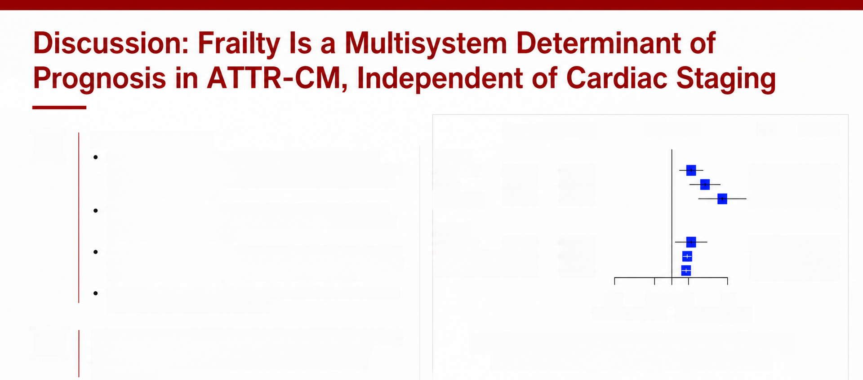
01
Synthesis of findings:
logRR SE(logRR)
Risk Ratio
lear risk
95%-Cl
Roughly one-third of ATTR-CM patients are frail—a substantially
higher proportion than in other cardiovascular conditions (11.7–23.8%
Frailty
pre-frail
Frailty
0.7975
1.3686
2.0844
0.2465
2.22 [1.37; 3.60]
3.93 [2.09; 7.39]
8.04 [3.01; 21.48]
in heart failure trials such as DELIVER, DAPA-HF, PARAGON; 6.1%
in aortic stenosis cohorts)
0.3225
Very Frail
0.5013
A clear risk gradient exists: pre-frail (RR 2.22), frail (RR 3.93), and
severely frail (CFS≥8: RR 8.04, 95% CI 3.01–21.48) patients show
progressively higher mortality
6MWD
Frailty also predicted increased cardiovascular mortality (HR 10.63),
poorer quality of life, and reduced prescription of disease-modifying
treatment (odds reduced by ~80% even after adjustment)
Baseline
0.7975
0.3370
2.22 [1.15; 4.30]
1.89 [1.60; 2.23]
1.80 [1.52; 2.14]
>5% reduction 0.6366
>35m reduction 0.5878
0.0847
0.0873
The most common reason for withholding or discontinuing tafamidis
was perceived frailty or poor mobility
0.1
0.5 1 2
10
Lower Mortality
higher mortality
02
Proposed model: Frailty reflects systemic physiological vulnerability
encompassing sarcopenia, malnutrition, and reduced exercise
Frailty, including 6MWD, were prognostic markers
of mortality among patients with ATTR-CM
capacity—that is not captured by cardiac biomarkers or staging
systems alone
03
Novel contribution: This is the largest synthesis to date (5048
patients, 5 frailty instruments), extending beyond a prior smaller
Fig. 5: Overview of key study findings across 16 studies and 5565 patients with
ATTR-CM, highlighting frailty prevalence and the prognostic roles of the Clinical
Frailty Scale and 6-minute walk distance
meta-analysis restricted to CFS alone
Notes:
Bringing these findings together, this figure summarizes the overall study conclusions. Across the 16 studies and over 5500 patients, frailty affects roughly one in three individuals with ATTR-CM—a substantially higher proportion than seen in other cardiovascular conditions such as heart failure or aortic stenosis trials, where frailty prevalence is typically well under 25 percent. There is a clear dose-response gradient of risk, with severely frail patients, defined by a Clinical Frailty Scale score of 8 or above, facing over an eight-fold increase in mortality. Beyond mortality, frailty was also linked to worse cardiovascular outcomes, poorer quality of life, and importantly, a substantially reduced likelihood of receiving disease-modifying treatment such as tafamidis—often because clinicians perceived these patients as too frail or immobile to benefit, despite evidence suggesting otherwise. The authors propose that frailty captures a systemic, multisystem vulnerability—involving muscle wasting, malnutrition, and reduced exercise capacity—that is simply not visible on standard cardiac biomarkers or staging systems. This work represents the largest synthesis of frailty data in this disease to date, substantially extending a prior smaller meta-analysis that relied solely on the Clinical Frailty Scale.

Slide 11










Conclusion, Limitations, and Future Directions
01
02
03
Main conclusions:
Limitations:
Future Directions:
Frailty and pre-frailty are common and
independently associated with increased
all-cause mortality in ATTR-CM
Substantial heterogeneity from diverse
frailty tools and cutoffs (I² ~50–70%)
Standardize frailty instruments across
future ATTR-CM studies
Small number of studies (only 6
reporting mortality); formal publication
bias testing not possible (k < 10)
•Investigate frailty-targeted interventions
(structured exercise, nutritional
optimization, anti-sarcopenic therapies)
Baseline and interval change in 6MWD are
practical, objective functional surrogates
that predict outcomes
Findings pertain to ATTR-CM; insufficient
AL amyloidosis data to generalize
Frailty is associated with poorer quality of
life and reduced access to disease
modifying therapy
Extend serial frailty assessment and study
frailty in AL amyloidosis and female
Male-predominant cohorts (87.3%) limit
generalizability to women
patients
Findings support incorporating
standardized frailty assessment
(CFS ± 6MWD) alongside National
Amyloidosis Centre staging into
routine ATTR-CM care
Frailty assessed cross-sectionally in
most studies, limiting analysis of
temporal change
Committed to advancing knowledge and improving patient outcomes.
Notes:
To conclude, this meta-analysis demonstrates that frailty and pre-frailty are common in ATTR-CM and independently predict higher mortality, that 6-minute walk distance offers a practical functional surrogate for risk stratification, and that frail patients face poorer quality of life and are less likely to receive disease-modifying treatment. These findings support integrating standardized frailty assessment, using the Clinical Frailty Scale alongside 6MWD, into routine amyloidosis care pathways. That said, the study has important limitations: substantial heterogeneity across frailty tools, a small number of studies reporting mortality which precludes formal publication bias testing, findings that apply specifically to ATTR-CM rather than AL amyloidosis, a male-predominant cohort limiting generalizability to women, and largely cross-sectional frailty assessment that cannot capture how frailty changes over time. Looking forward, the field would benefit from standardizing frailty instruments, testing targeted interventions such as exercise and nutritional programs to see if frailty trajectories can be reversed, and extending this work to AL amyloidosis and to female patients specifically.

Slide 12










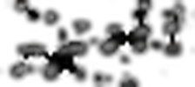


Acknowledgements
01
Funding: ASK reports grant funding from the National Medical
Research Council of Singapore (MOH-001200, MOH-000153)
Contributors: HJ and DJL (Writing – Original Draft, Methodology,
Formal Analysis); CYK, SAMC, RW, RST, YC, SD (Writing
Review & Editing); FG (Methodology, Writing – Review & Editing);
ASK (Conceptualization, Writing – Review & Editing, Validation)
02
03
Data availability: No new data were generated or analyzed
in support of this research
Notes:
I'd like to close by acknowledging the funding and contributions behind this work. Funding for the corresponding author was provided by the National Medical Research Council of Singapore. This was a collaborative effort across multiple contributors handling writing, methodology, formal analysis, and validation. As this was a meta-analysis of previously published data, no new patient data were generated for this study. Thank you for your attention, and I'm happy to take any questions.

