Slide 1
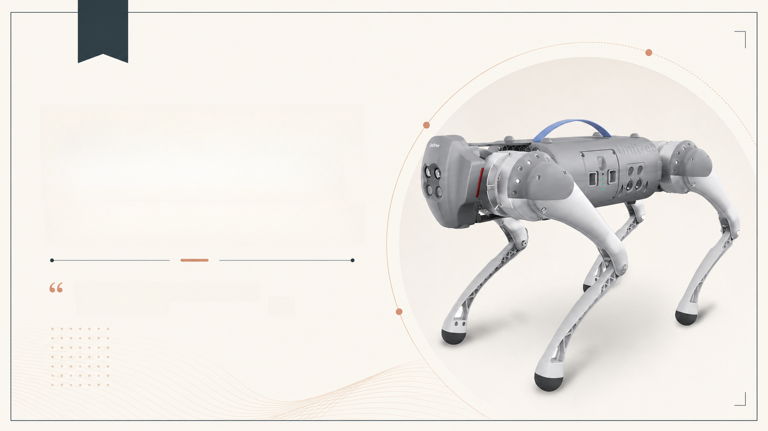
GO1 Quadruped
Robot Platform
User Manual v1.4
Fig. shows the cover image of the GO1
User Manual v1.4
99
Notes:
Good morning/afternoon everyone. Today I'll be walking you through the GO1 User Manual, version 1.4, released in December 2021. This document is the official guide for the GO1 quadruped robot platform developed by Unitree. Rather than a traditional research paper, this is a technical user manual, so our presentation will focus on understanding the product, how it is set up and operated, its technical specifications, and the safety and support information a user needs to know. Let's begin with an overview of what we'll cover.

Slide 2








































Agenda
01
02
03
Introduction:
Background:
Methodology:
Product overview and
intended client/user
System architecture and
operating modes
Setup, startup, and
shutdown procedures
04
05
06
Results:
Discussion:
Conclusion:
Technical specifications of
the battery pack and
remote control devices
Safety guidelines and
special-case handling
After-sales policy and
summary of key takeaways
Notes:
Here is the roadmap for our talk. We'll start by introducing the GO1 robot and who it is designed for. Then we'll look at its internal architecture and the different operating modes it supports. After that, we'll go through the practical steps of setting up, starting, and shutting down the robot. The core of our discussion will be a detailed breakdown of the technical specifications for the battery pack and remote control devices. Finally, we'll cover important safety guidelines, how to handle abnormal situations, and wrap up with the after-sales policy and a summary of the manual's key points.

Slide 3
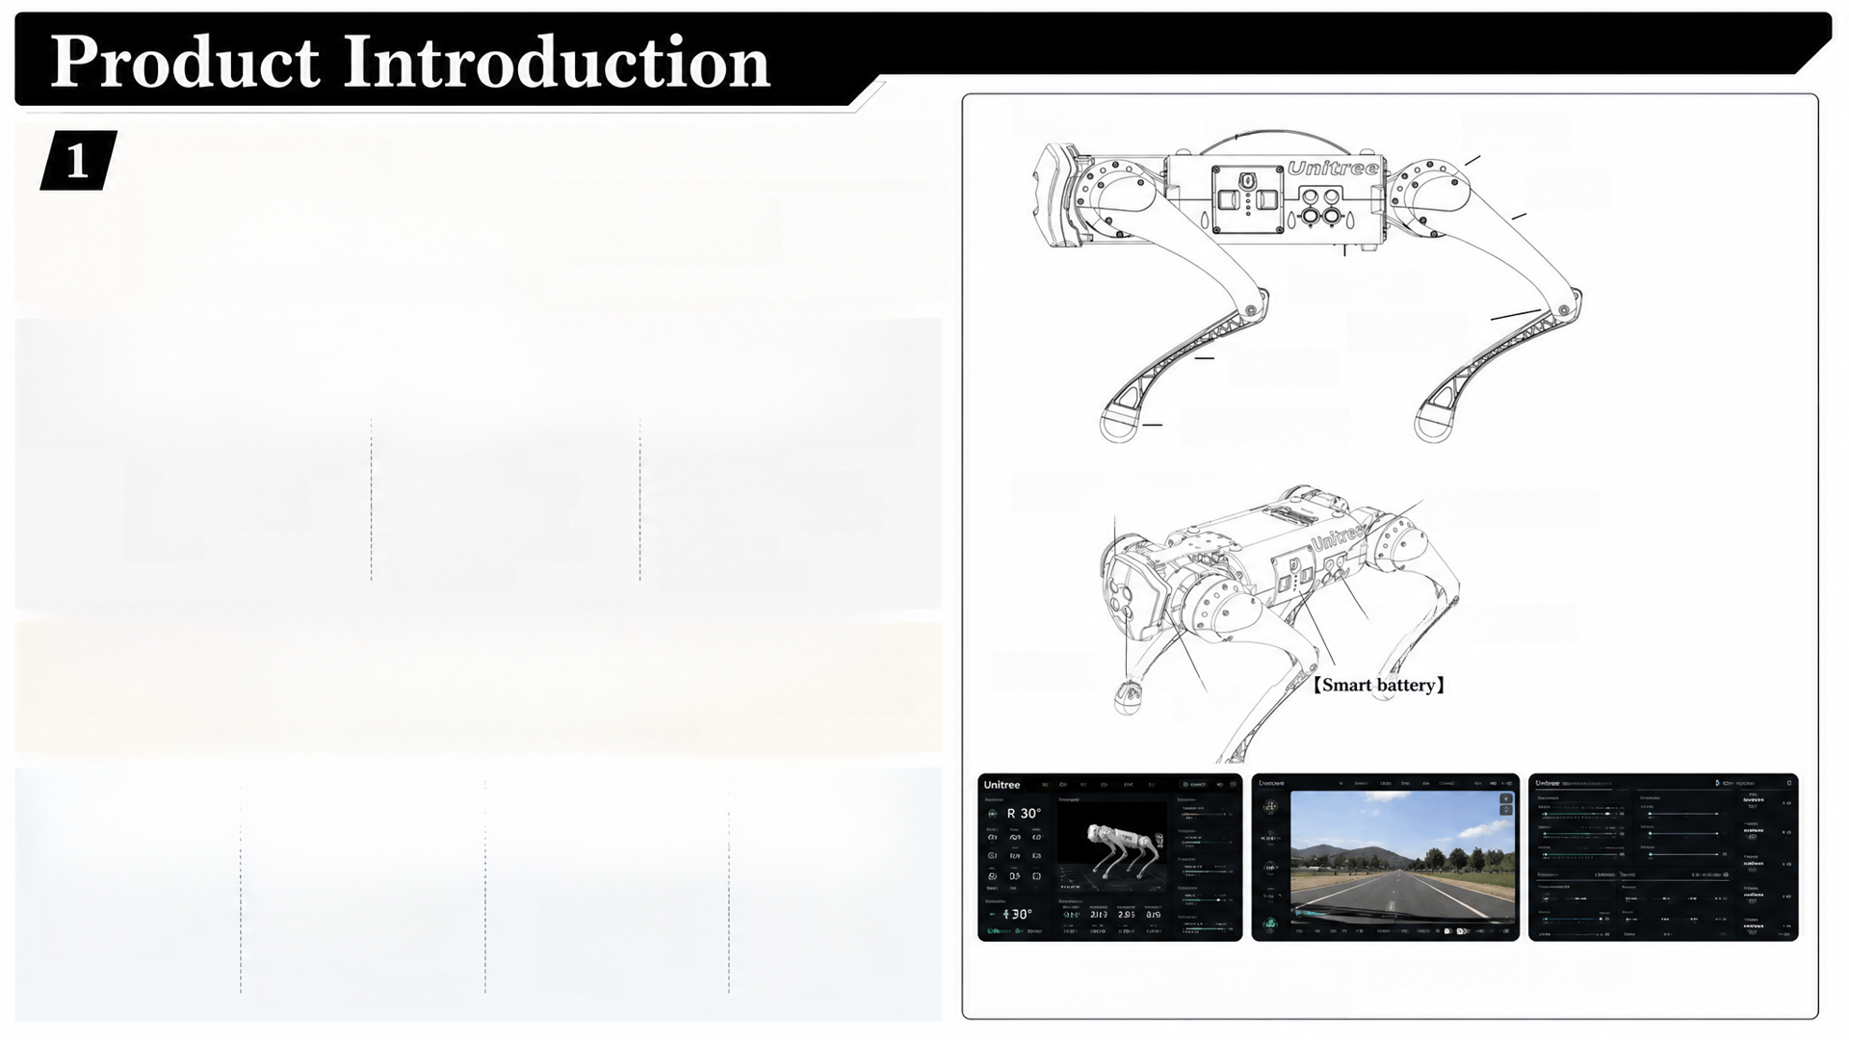



Dog head】
【body】
【Hip joint】
Product Overview:
【Thigh】
The GO1 is a high-motion-performance quadruped robot platform
consisting of the quadruped robot itself, a wireless positioning tag,
a remote control, and supporting software
【support pad】
【Knee-joint】
Core Technology:
【lower leg】
【foot force sensor】
12 degrees of freedom,
driven by 12 high
Force control
Streamlined
technology enables
compound control
of force and position
at each joint
mechanical structure
for improved reliability
【Stereo depth camera】
【Ultrasonic sensor】
performance servo
motors
and ease of
manufacturing
【Stereo depth camera】
Target Client/User:
【Ultrasonic sensor】
Individuals and organizations seeking a lightweight, mobile robotic
platform for scientific exploration and field-level applications
【Led】
Feature Highlights:
Super-sensing system
combining fisheye
Total body weight of
only 12kg, making
it easy to carry
ISS companion system
using patented wireless
vector positioning for
APP-based multi
camera fusion
binocular cameras
and ultrasound for
enabling remote
'God's perspective'
autonomous
autonomous route
selection
Fig. shows the robot part names and integration/underlying processor
monitoring interfaces of the GO1 robot
accompanying/following
operation
Notes:
Let's start with the product itself. The GO1 is described as a high-motion-performance quadruped robot platform. It's not just a robot dog—it's a complete system that includes the robot, a wireless positioning tag worn by the user, a remote control, and companion software. Mechanically, it has 12 degrees of freedom, powered by 12 servo motors, and it uses force control technology to manage both the force and position of each joint simultaneously, which gives it excellent movement performance. The intended client is anyone exploring scientific or field-level applications who needs a reliable, cost-effective four-legged mobile platform. What makes GO1 stand out is its light weight—just 12kg—and its companion system, which uses wireless vector positioning so the robot can walk alongside a person rather than simply following behind, which is a more natural interaction. It also has a super-sensing system combining cameras and ultrasound so it can autonomously navigate around obstacles, and its app supports a multi-camera 'God's perspective' for remote operation.

Slide 4

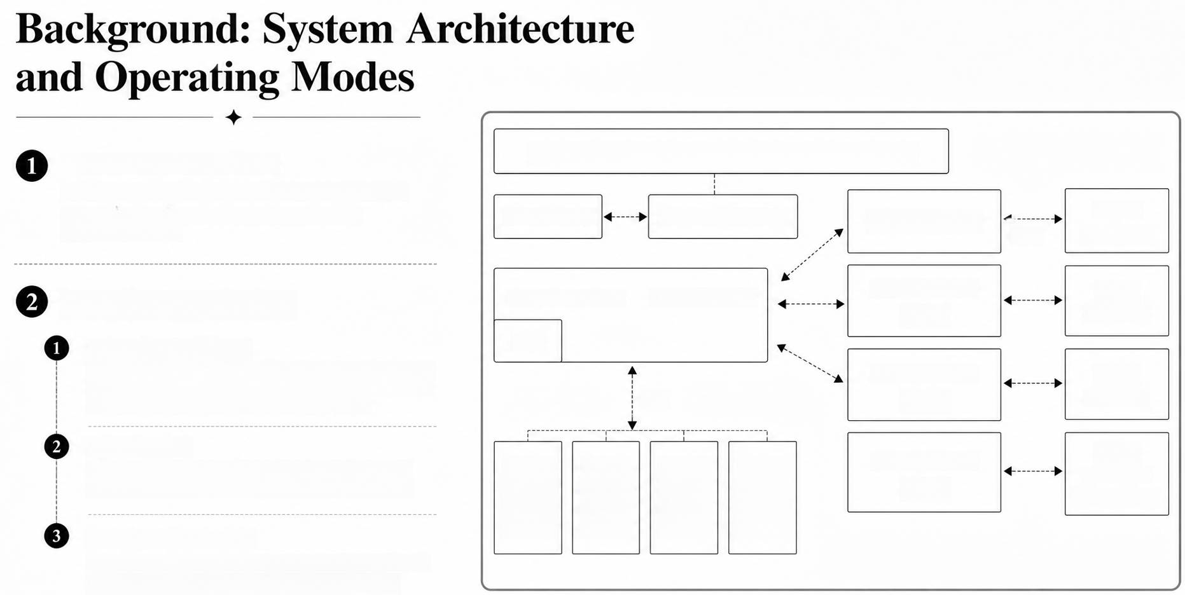
Hardware Architecture:
External power source, External power supply (5V、12V、19V)
GO1 uses a new hardware architecture and control
system integrating processors, sensors, and
motor controllers
Smart battery
Power management
(Raspberry Pi 4)
sensors
(realsense)
USB
Operating States/Modes:
Master controller
Ethernet switch
NANO-1-4GB
(Body)
Depth
camerax2
Static Standing State:
IMU
Body held at initial standing height, level, no handle input;
lowest power consumption and longest endurance; 3-axis
attitude and 3-axis position control via joystick
NANO-2-4GB
(Body)
Depth
camerax1
485
Sports Mode:
Depth
camerax2,
Robot stands up automatically after startup; supports
walking, fast running, and other dynamic movements
Leg[FR]:
Motor[1]
Motor[2]
Motor[3]
Leg[FL]:
Motor[1]
Motor[2]
Motor[3]
Leg[RR]:
Leg[RL]:
Motor[1]
Motor[2]
Motor[3]
NANO-3-2GB
Motor[1]
Motor[2]
Motor[3]
(head)
Ultrasoundx1
Accompanying Status:
Activated after 1 minute of standby (indicated by flashing
head light strip); robot dynamically follows the tag
controller and avoids obstacles in real time
Fig. shows the GO1 robot's internal hardware architecture and control system
Notes:
Before we get into operating the robot, it's important to understand its underlying architecture. GO1 uses a new control system architecture, shown here, which integrates its processors and sensing components to enable coordinated motor and joint control. Built on top of this architecture are three main operating modes. The first is Static Standing State, where the robot just stands at its initial height with no movement—this uses the least power and gives the longest battery life. The second is Sports Mode, where after startup the robot stands on its own and can walk or run. The third is Accompanying Status, which kicks in about a minute after standby; here the robot uses the tag controller to dynamically follow a person and avoid obstacles in real time. Understanding these modes is essential context for the setup and control procedures we'll cover next.

Slide 5



Setup, Startup, and Shutdown Procedures
1
Preparation Before Starting Up:
Install the battery pack, ensuring correct orientation
without forcing it
2
Body placement: robot must be on level ground with
the abdominal support pad flat and calves fully stowed
3
Connect the remote control module (joystick and mobile
phone) via one-to-one pairing and Bluetooth/WiFi
Startup Procedure:
Short press then long press (>2 seconds) the power switch; robot
performs a self-test and stands to initial height if successful
3
Shutdown Procedures:
Confirm robot is in Static Standing State on level ground
2
3
Hold L2 + click A three times (squat, stand, lie down sequence)
Hold L2 + click B twice (damped, then undamped prone position)
4
Fig. shows the correct body placement of the robot
on level ground prior to startup
Power off the battery once in the undamped prone state
Notes:
Now let's walk through the actual process of getting the robot up and running. Before starting up, the user must install the battery pack carefully—forcing it in the wrong direction can damage the connector—and place the robot's body flat on level ground, as shown in this figure, with its calves fully stowed. The remote control module, consisting of the joystick and a mobile phone, is then connected through automatic pairing and Bluetooth or WiFi. To start the robot, the user gives a short press followed by a long press of the power switch; the robot then runs a self-test and, if successful, stands up to its initial height. Shutdown follows a very specific sequence: the user must confirm the robot is standing statically, then use a combination of button presses on the joystick—holding L2 while clicking A three times to cycle through squat, stand, and lie-down states, then holding L2 while clicking B twice to move into damped and then undamped prone positions—before finally powering off the battery. This careful sequence prevents the robot from collapsing unpredictably.

Slide 6
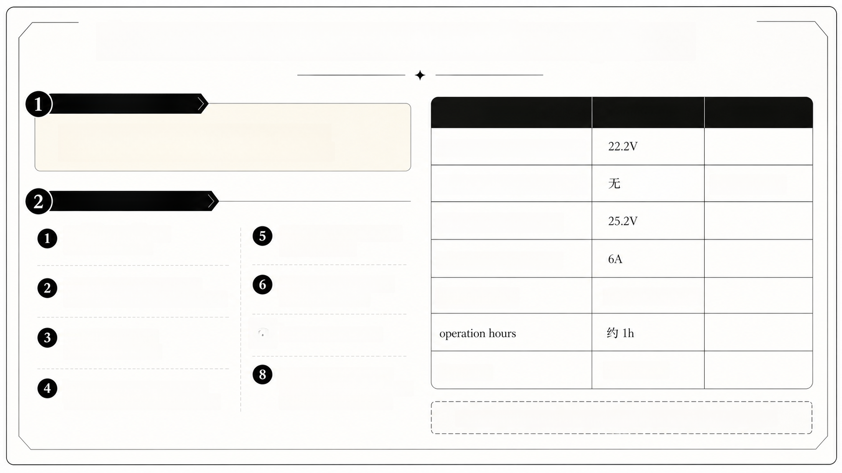
Technical Specifications – Battery Pack
Battery Specification:
parameter
Specifications
Remark
Capacity of 6300 mAh at a voltage of 21.6V, with an
integrated charge and discharge management system
Rated voltage (power supply)
Rated current (power supply)
Current jump
Key Protective Features:
Rated voltage (charging)
Battery display showing
current charge level
Charging current protection
(stops above 4A)
Rated current (charging)
Self-discharge protection above
65% charge after 10 days of inactivity
Over-discharge protection
(cuts output at 18V)
Rated Capacity
6000mAh,133.2Wh
Balanced charge and
overcharge protection
0
Short circuit protection
Load detection protection
frequency
4492.8MHz
Charging temperature protection
(abnormal below 5°C or above 55°C)
(auto shutdown after 3 seconds
with no connected device)
Table shows the technical specifications of the GO1 battery pack
Notes:
Turning now to the technical specifications, let's start with the battery pack, since this is one of the most safety-critical components of the system. As shown in this table, the battery pack has a capacity of 6300 milliamp-hours and operates at 21.6 volts. What's particularly noteworthy is the number of built-in protective features: it manages self-discharge to protect long-term battery health, it balances internal cell voltages, it prevents overcharging and enforces safe charging temperatures between 5 and 55 degrees Celsius, and it limits charging current to below 4 amps. It also has over-discharge protection that cuts off output at 18 volts, short-circuit protection, and a load detection feature that automatically shuts the battery down if no device is connected within 3 seconds. These layered protections are designed to prevent the fire and explosion risks that are common concerns with high-capacity lithium battery packs.

Slide 7















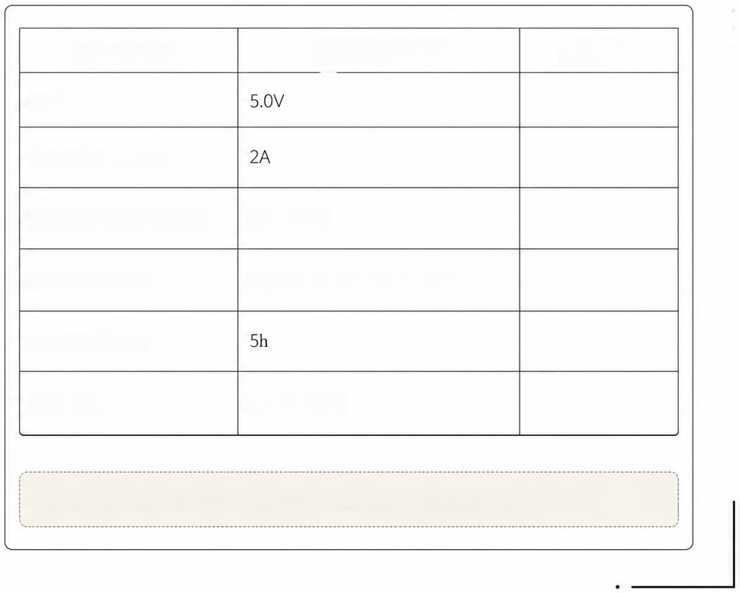

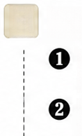

Technical Specifications – Remote Control Devices
1
Joystick (Remote Control Module):
Controls 3-axis attitude and 3-axis position when standing
parameter
Specifications
Remark
2
Supports forward/backward, side shift, in-place turning, and
rule-based walking patterns (straight line, circle, arc, rectangle)
Charging voltage
Connects to mobile phone via Bluetooth for stable
signal transmission
recharging current
Lithium battery capacity
3000mAH
2
Label (Tag) Controller:
Enables full 3-axis posture and position control,
plus autonomous following
Communication
Digital transmission、wifi, bluetooth
Supports slow (max 1.5 m/s) and fast (max 3.0 m/s)
auto-follow modes
operation hours
New folding design for improved portability
Distance
Above 100M
3
Operational Constraint:
The APP and the tag controller cannot control the robot
simultaneously; one must be disabled to use the other
Table shows the technical specifications of the GO1 joystick remote control
Notes:
The second major set of specifications concerns the remote control devices. There are two: the joystick, which is part of the remote control module and connects via Bluetooth, giving stable full 3-axis control over the robot's posture and position as well as pattern-based walking; and the label, or tag, controller, which enables the autonomous companion mode we discussed earlier, with a slow follow mode capped at 1.5 meters per second and a fast mode up to 3.0 meters per second. This table lists the detailed technical specifications for the joystick. One important operational constraint to note is that the mobile APP and the tag controller cannot be used to control the robot at the same time—users must explicitly disable one before using the other, which is a detail worth remembering for anyone deploying this system in practice.

Slide 8



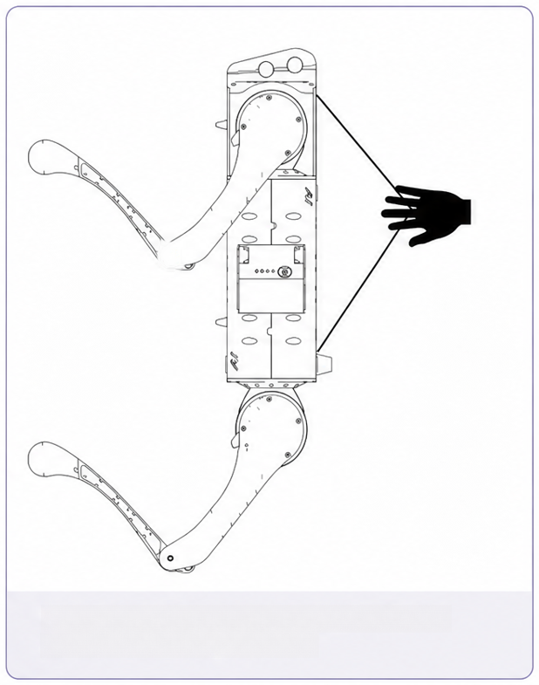


Safety Guidelines and Special-Case Handling
1
Environmental Requirements:
2
Robot Black Box:
1
1. Operate only in an electromagnetically and
WiFi-interference-free environment
Continuously records IMU data,
joint angle/speed, force sensor
data, and control commands to
diagnose faults
2. Operate at 5°C–35°C, avoiding fog, snow,
rain, lightning, or sandstorms
o
3. Maintain at least 3 meters distance from
obstacles, complex ground, crowds, and water
3
Emergency Braking:
Requires the official protective
4
4. Avoid steps above 10cm and slopes
greater than 25°
frame and rope; without it,
cutting power will cause the
robot to fall and may cause
serious damage
Forced Shutdown Procedure:
If the remote control module fails, use a nylon belt to suspend the robot before
manually powering off via the battery switch
Fig. illustrates the preparations required before
a forced shutdown of the robot
Notes:
Given that this is a physical robot capable of dynamic, sometimes unpredictable movement, safety guidance occupies a substantial part of the manual. Users are instructed to operate only within a controlled temperature range, away from electromagnetic and WiFi interference, and to keep a minimum 3-meter distance from obstacles and people. There are also strict limits on terrain—steps under 10cm and slopes under 25 degrees. To help diagnose problems when they occur, the robot includes a 'black box' that continuously logs sensor and control data, similar in concept to a flight recorder. One of the more critical safety procedures is emergency braking: this must only be used with the official protective frame and rope in place, because cutting power without protection causes the robot to drop and potentially sustain serious damage. The manual also details a forced shutdown procedure for when the remote control fails—shown in this figure—where the user threads a nylon belt through the robot's suspension board to hold it steady before manually powering it down. These procedures underscore that this is a serious piece of hardware requiring careful, informed handling.

Slide 9
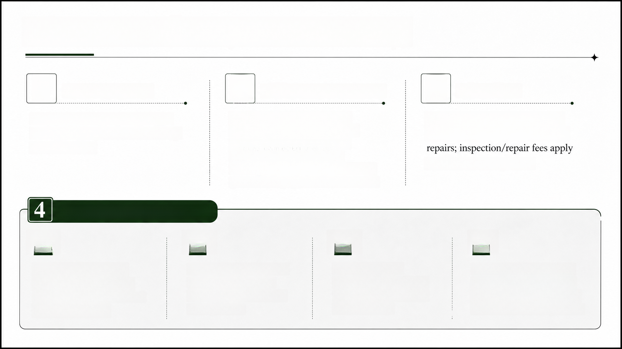
After-Sales Policy and Summary
1
2
3
Warranty Period:
Maintenance Exclusions:
Other Rules:
One year from the date of receipt;
voided by unauthorized disassembly
or modification
Damage from improper use,
non-official batteries/chargers,
extreme environments, falls,
collisions, or unauthorized
developer-mode operation without
Users bear return shipping costs;
Unitree covers costs for qualifying
for out-of-warranty issues
protective equipment is not covered
Summary of Key Takeaways:
01
02
03
04
GO1 is a 12-DOF, 12kg
Careful startup/shutdown
sequences and battery
Detailed technical
Strict safety guidelines and
after-sales exclusions place
quadruped platform with
specifications govern the
battery pack and remote
control devices
autonomous companion and
handling are essential for
safe operation
significant responsibility on
sensing capabilities
the user for correct operation
Notes:
Finally, let's close with the after-sales policy and a summary. The GO1 comes with a one-year warranty from the date of receipt, but this warranty is voided by unauthorized disassembly or modification. Importantly, the manual lists a long set of exclusions—damage from improper use, non-official batteries, extreme environments, falls, or unsupervised developer-mode operation without the protective frame are all explicitly not covered. Users are also responsible for return shipping costs in most cases. To summarize everything we've covered today: the GO1 is a compact, 12-degree-of-freedom quadruped robot with autonomous following and environmental sensing capabilities; its safe operation depends on following precise startup and shutdown sequences and careful battery management; its technical specifications for the battery and remote controls are extensive and safety-oriented; and the after-sales policy makes clear that correct operation and adherence to the manual's guidelines are ultimately the user's responsibility. Thank you, and I'm happy to take any questions.

